Slide 1
CLIENT
“HOW TO DO GUIDE”

Slide 2
POST SHIFTS OVERVIEW

Slide 3
POST SHIFTS

Slide 4
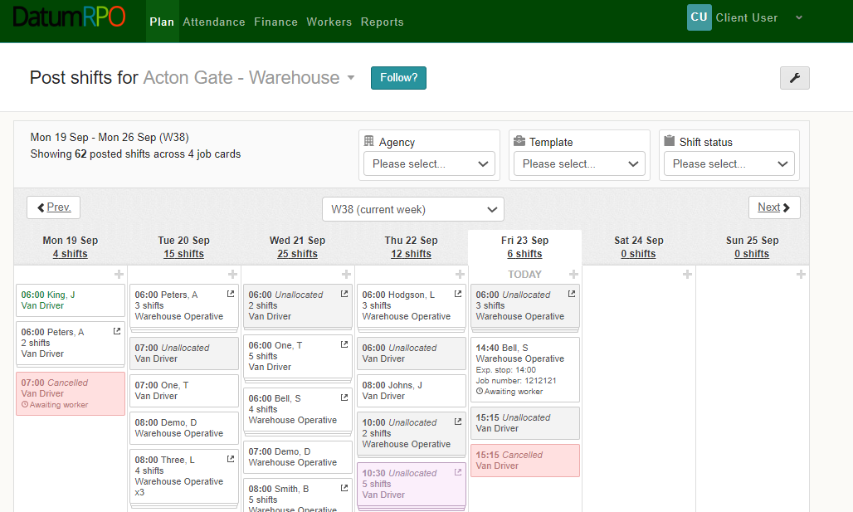
Where Do I Go To Post Shifts?
To create and post shifts, go to ‘Plan’ and ‘Post Shifts’.

Slide 5
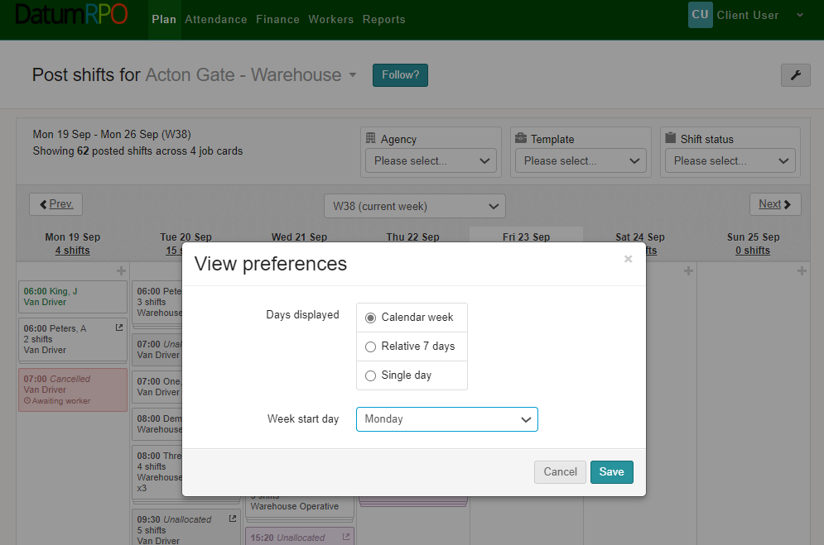
How Do I Change My View Preferences?
You can change your view preferences by clicking on the wrench icon at the top of the page.

Slide 6
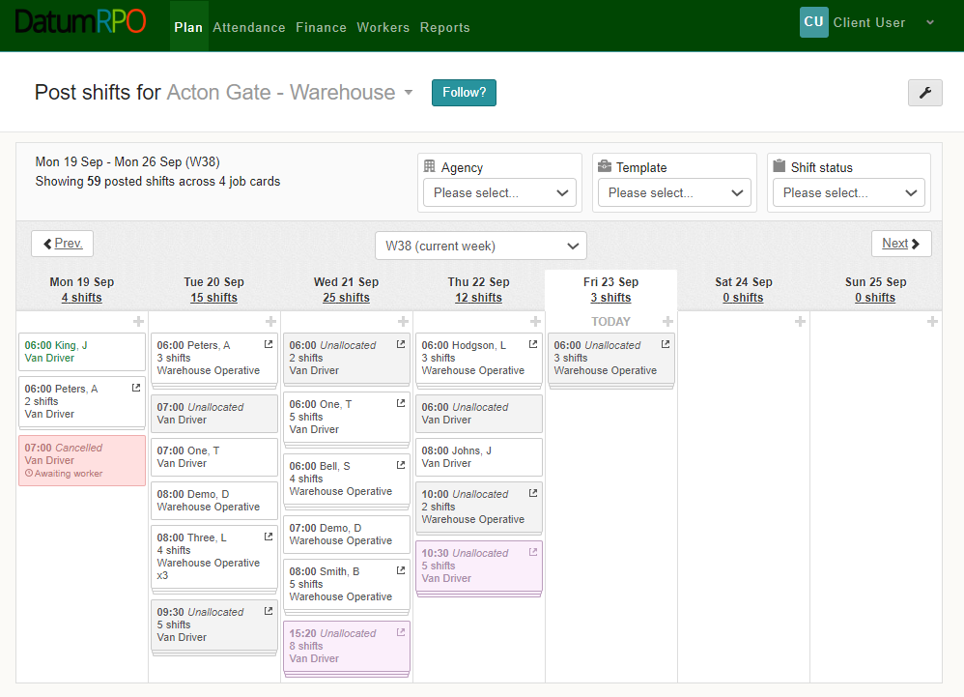
How Do I Filter My Plan?
You can filter your plan to view your booking by ‘Agency’, ‘Order Template’ or ‘Shift Status’ using the dropdowns.

Slide 7
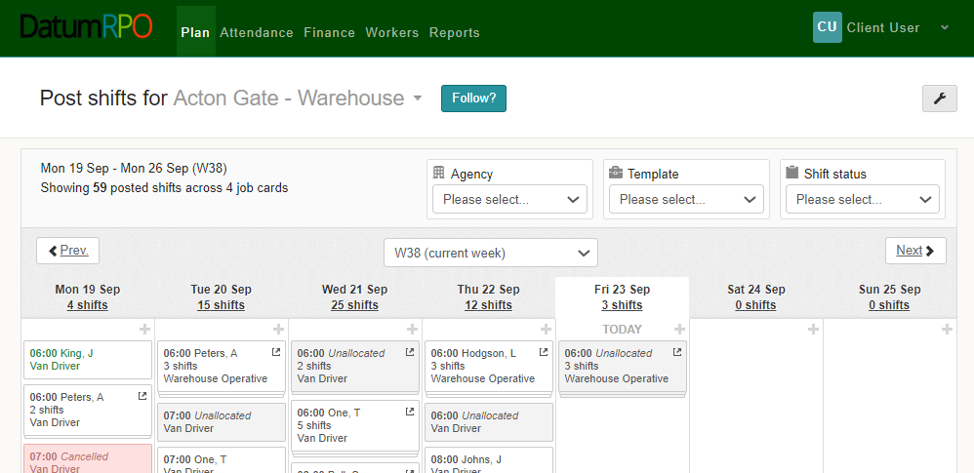
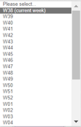
How Do I Change My Plan Week?
You can change your plan week by selecting an alternative week from the dropdown box, you can also move or forward one week at time by using the buttons.

Slide 8
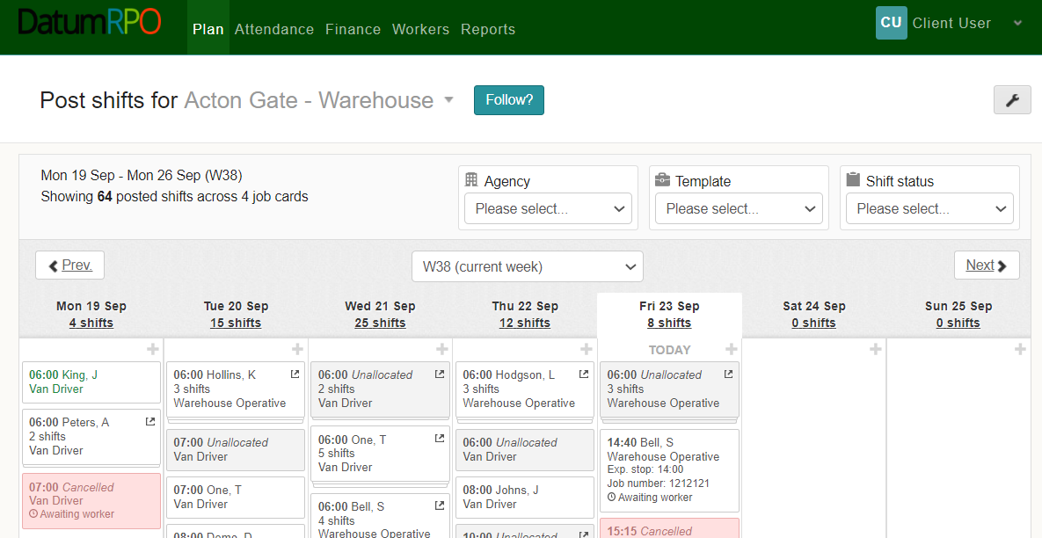
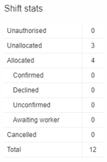
How Do I View The Shift Stats?
Clicking on the number of shifts will reveal the shifts stats for the day.

Slide 9
Where Do I See My Shifts?
You can see the days & dates of the week with the number of shifts below.

Slide 10
How Do I Create New Shifts?
To create a new shift, click on the in the day you want to create the shifts on.

Slide 11
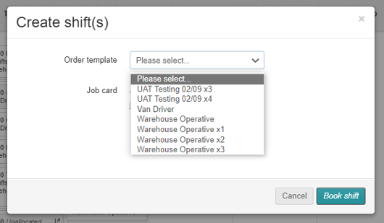
How Do I Create New Shifts?
Next, select the order template you wish to create your new shifts for by selecting it from the dropdown box.

Slide 12
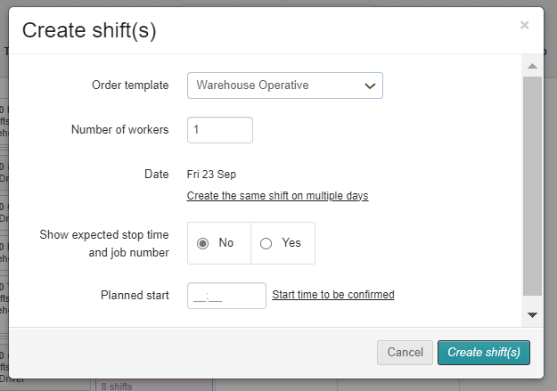
How To Book The Numbers Required?
Enter the number of workers you require and the planned start time of the shift.
You can also create the same shift on multiple days by clicking on the hyperlink.

Slide 13
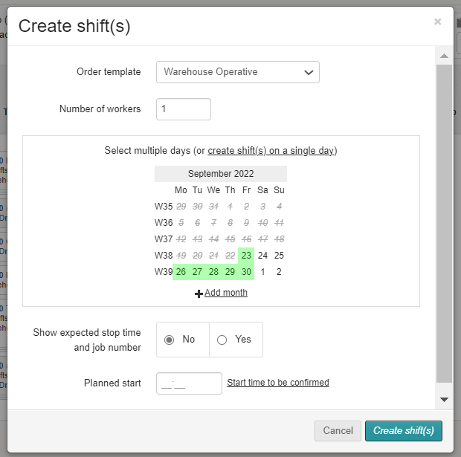
How Do I Select Multiple Days?
If you choose to create the same shift on multiple days by clicking on the hyperlink, you will see a calendar view where you will be able to select multiple days to create the same shift. The dates will turn green when selected and white when de-selected.
You can also add additional months to allow you to create the same shift well into the future.

Slide 14
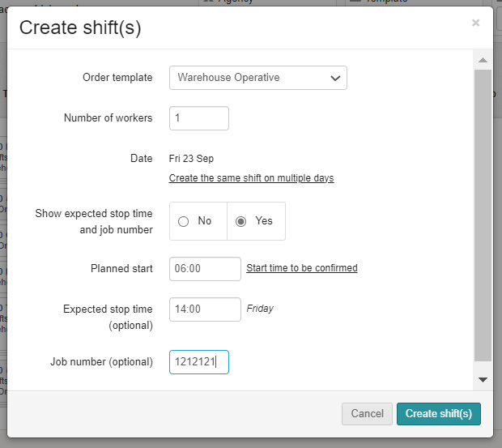
How Do I Add Stop & Start Time Required For The Shift?
You also have the option to show the expected stop time and job number of the shift.
If you select ‘Yes’, here.
When you are ready to create your shifts – click

Slide 15
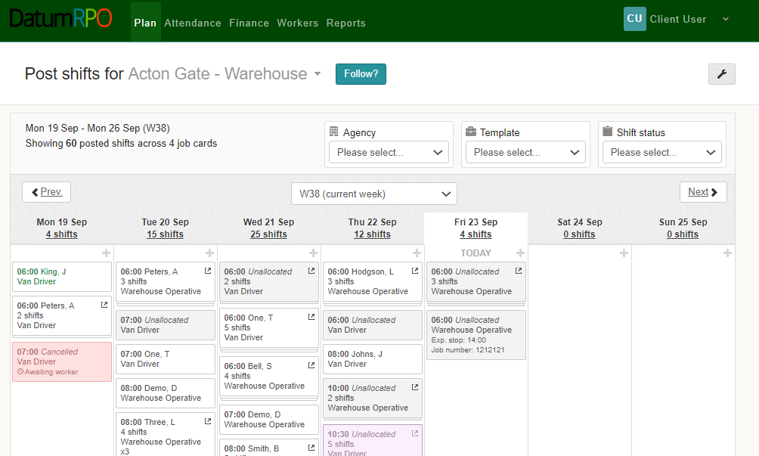
How Do I See They Have Been Posted?
You will now be able to see your Posted shift in the plan waiting to be actioned by Datum RPO.

Slide 16
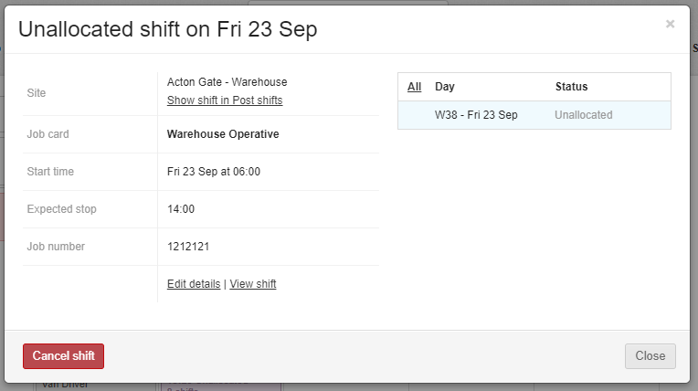
How Do I Edit Shift Details If Incorrect Or Need Cancelling?
You can ‘Edit’ or ‘Cancel’ unallocated shifts by clicking on the shift and selecting ‘Edit Details’ or ‘Cancel’ shift.

Slide 17
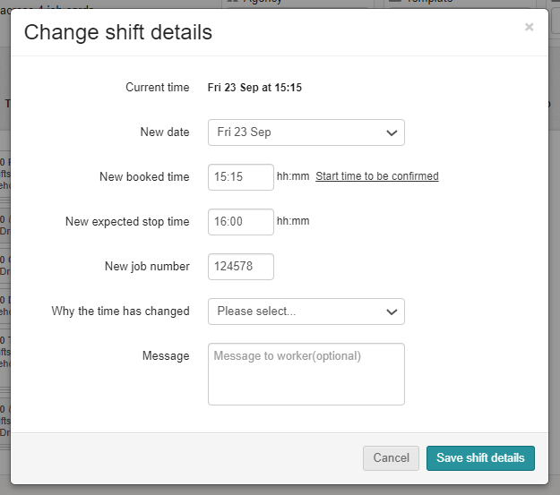
What Is The Reason The Time Has Changed?
When changing a shift time, you will need to add a reason for the time change using the dropdown box followed by saving.

