Slide 1
CLIENT
“HOW TO DO GUIDE”

Slide 2
POST SHIFTS OVERVIEW

Slide 3
POST SHIFTS
VIEW FILLED SHIFTS

Slide 4
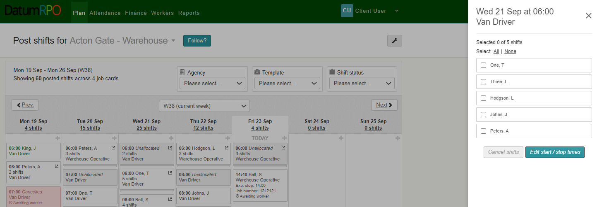
How Do I View My Filled Shifts?
To view the workers that have been allocated to your shifts, click on the booking and you will see a list of the workers who have been allocated as well as any unallocated shifts

