Slide 1
CLIENT
“HOW TO DO GUIDE”

Slide 2
POST SHIFTS OVERVIEW

Slide 3
POST SHIFTS
CANCELLED SHIFTS

Slide 4
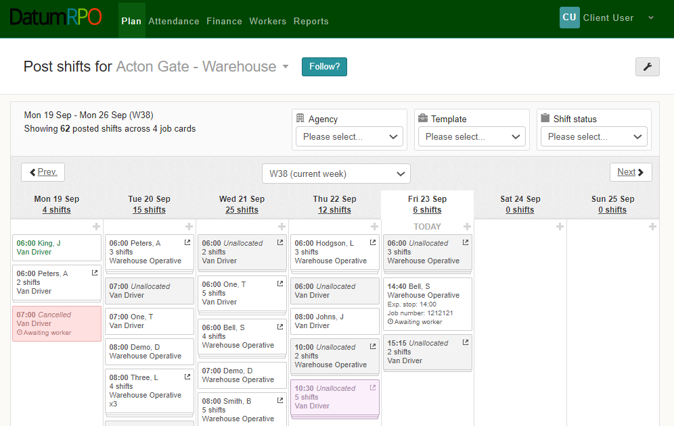
How Do I See Unallocated Shifts?
To cancel any unallocated shifts, click on the booking.

Slide 5
How Do I Cancel Shifts?
When cancelling shifts, you can cancel all or just one or more.
This section shows the unallocated shift.
Click on Cancel shift to complete

Slide 6
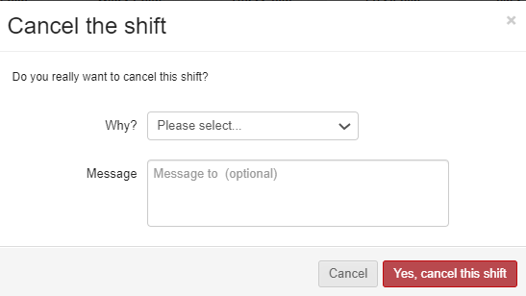
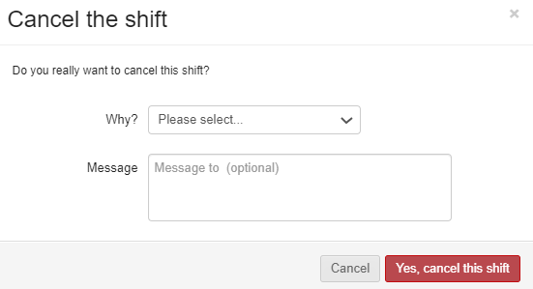
How Do I Advise Why The Shift Has Been Cancelled?
To add the reason why go to the dropdown section
Was it cancelled to incorrect planning – Planned in error
Or was a delivery late – Client Cancelled
If required, you can add a reason to why the shift has been cancelled

Slide 7
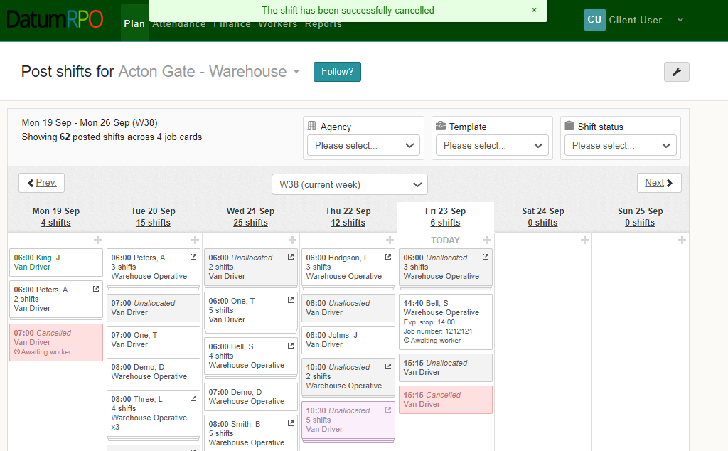
How Do I View The Cancelled Shift?
Once you have cancelled the shift you will get a notification on the top of the page
Also, the cancelled shift will turn pink

Slide 8
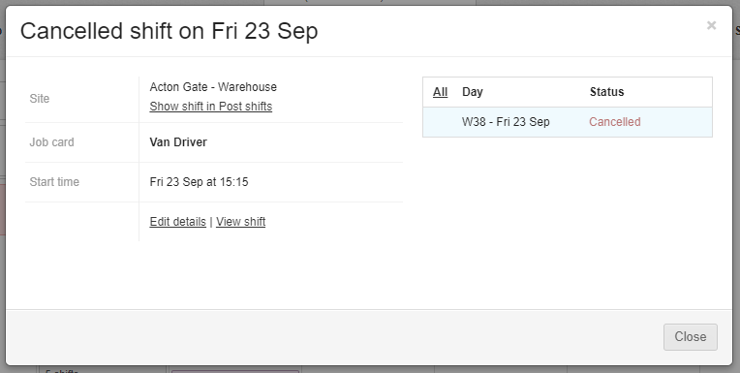
How Do I View The Cancelled Shift?
In the Status section you can see the order has now been cancelled for the Van Driver only

