Slide 1
CLIENT
“HOW TO DO GUIDE”

Slide 2
ATTENDANCE
“HOW TO VIEW WORKERS ON WHAT JOB CARD”

Slide 3
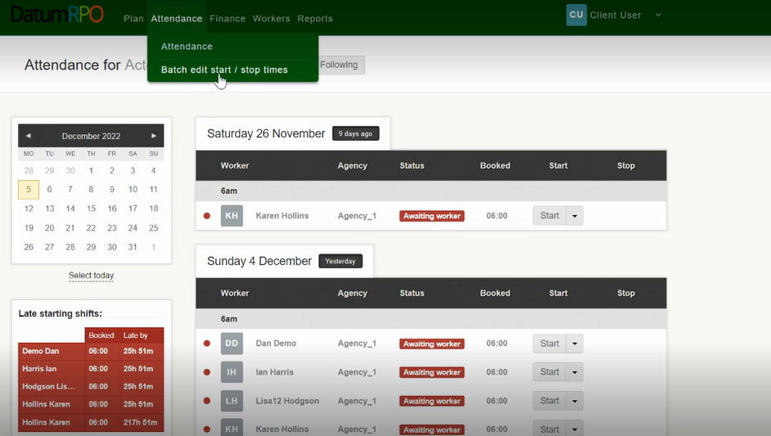
How To View Workers On Job Cards?
Go o attendance and Batch edit start / stop times

Slide 4
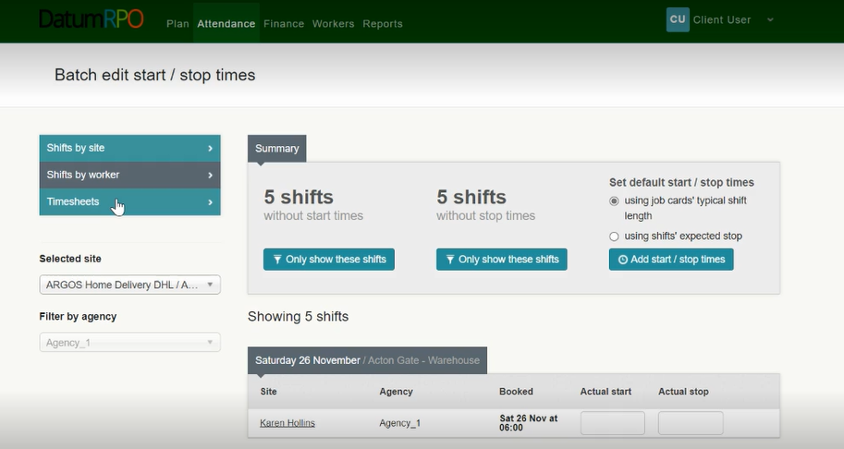
How To View Workers On Job Cards?
Next click on Timesheets

Slide 5
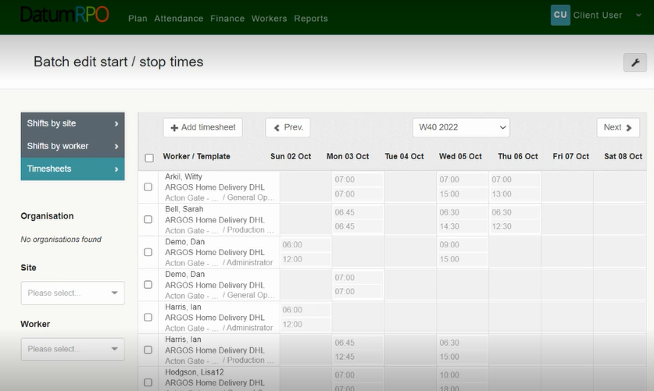
How To View Workers On Job Cards?
You can now see a list of workers in A-Z order attached to job cards.

Slide 6
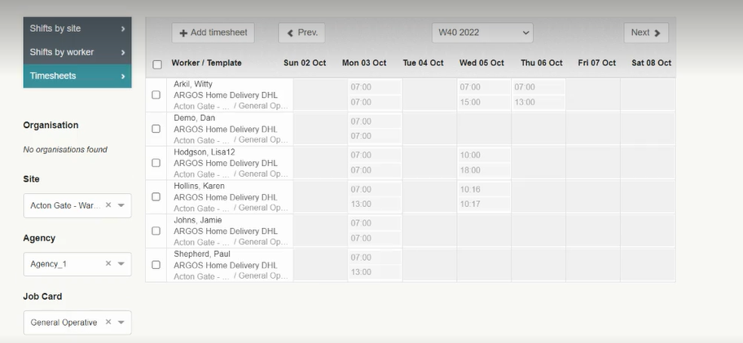
How To View Workers On Job Cards?
You can filter on your site, job card and agency to view your workers booked.
You can now view workers on a job card.

