Slide 1
CLIENT
“HOW TO DO GUIDE”

Slide 2
FINANCE OVERVIEW

Slide 3
TIMESHEETS

Slide 4
Where To Find Timesheets?
Timesheets are the start and finish times you have processed through either Stop/Start or Batch Edit Shifts.
Each day is processed as a timesheet, and you will be able to find them on each worker.

Slide 5
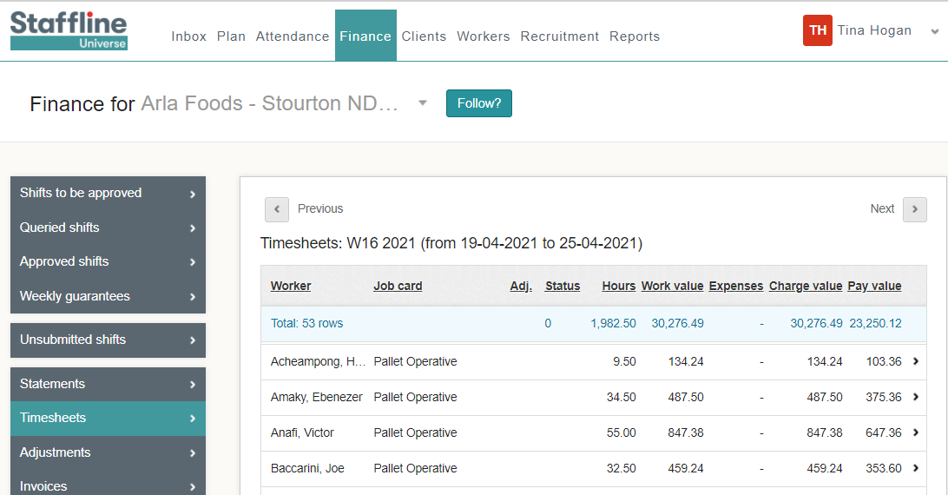
What's On The Timesheets?
Below is some information on the timesheets represented by different columns.
Status of open timesheets and unsubmitted
Total value to client for all workers
Total charge to client with adjustments for all workers
How many timesheets
Total pay for all workers
Total hours processed for all workers

Slide 6
What's On The Timesheets?
Further information on the timesheets represented by different columns.
Job card which the worker is being pay rolled on
Total value to client
Total pay to worker
Worker's name
Total charge to client with adjustments
Total hours processed

Slide 7
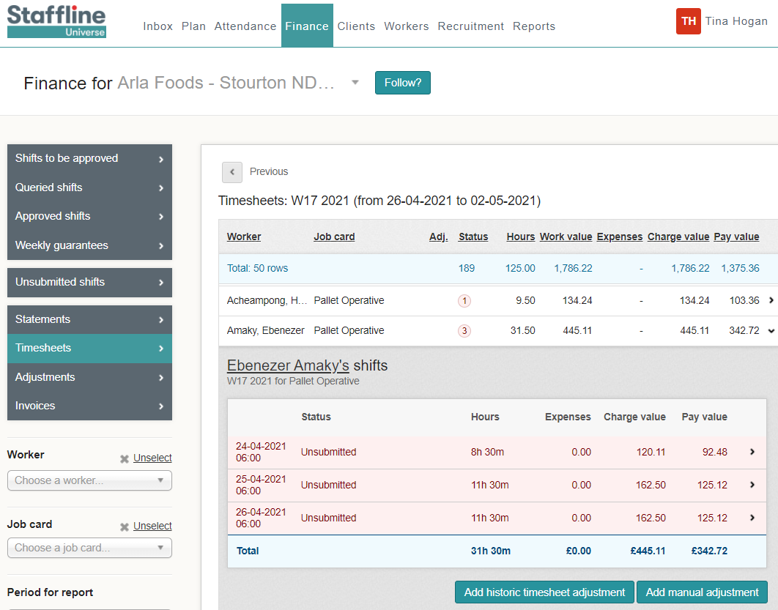
How To View Timesheets?
The timesheets represent each day the worker has worked, including hours processed
with charge and pay totals for each day.
Timesheets which have been created for the worker, that haven't yet been submitted and are highlighted pink

Slide 8
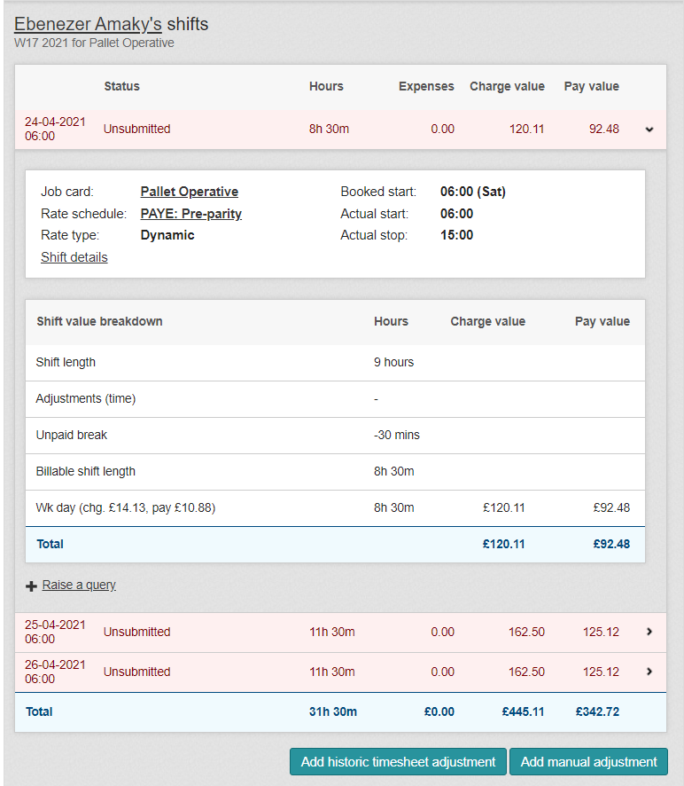
What Information Is On Each Timesheet?
Click on the day you would like to view. Each section represents the job card rules and hours processed.
The first part is information that has been placed on the job card.
You can also go to the job card from this section by either
clicking on:
Job Card
Rate schedule
Shift details

Slide 9
What Information Is On Each Timesheet?
The second part of the timesheet is the shift value breakdown.
This part shows the shift length, any adjustments, unpaid breaks and the total shift length billable to the client

Slide 10
What Information Is On Each Timesheet?
The last part of the timesheet is the total costs.
The final part is the charge rate, pay rate, hours, charge value and pay value

Slide 11
What Are Historic And Manual Adjustments?
These are for any missing payments or adjusted rates.
Please see the How To Guide on historic and manual adjustments
for more information.

Slide 12
UNSUBMITTED SHIFTS

Slide 13
What Is An Unsubmitted shift?
An Unsubmitted Shifts are timesheets that have been created and are waiting to be processed for payroll.
This is where you can check the hours and costing for each job card before submitting the Unsubmitted Shifts.
Go to Finance > Unsubmitted Shifts.

Slide 14
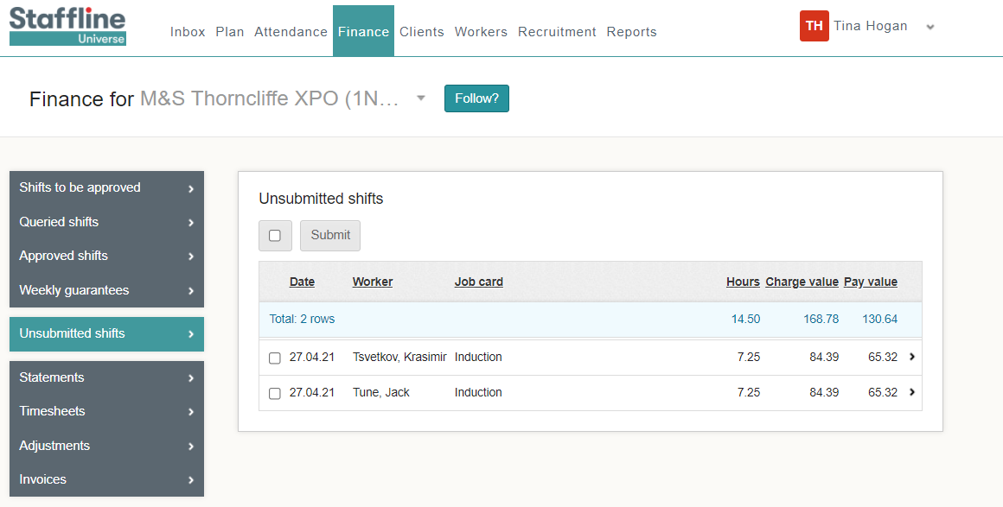
How To Submit Your Unsubmitted Shift?
You will be able to view all workers with hours on Universe.
When submitting unsubmitted shifts you are on your way to locking lines.
You can either submit all workers at a time or one by one.
For all workers you need to click on:
To submit worker's individually, click one box at a time.

Slide 15
QUERY SHIFTS

Slide 16
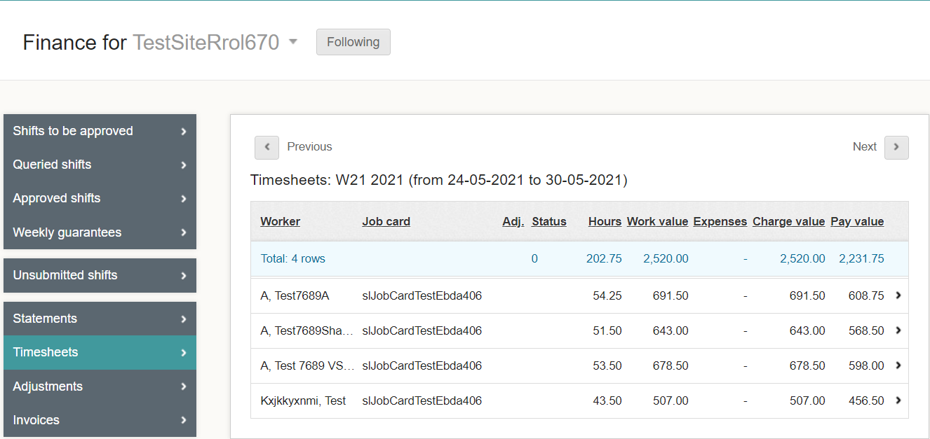
Where To Query A Shift?
A query is where you have processed hours, approved the shifts and then noticed they are overpaid or underpaid due to incorrect start/stop times.
Click on the worker where you need to
raise a query.

Slide 17
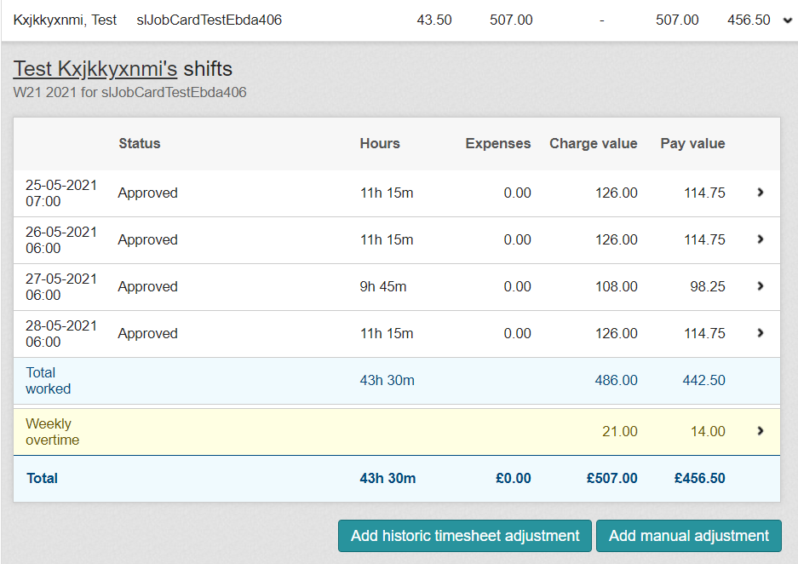
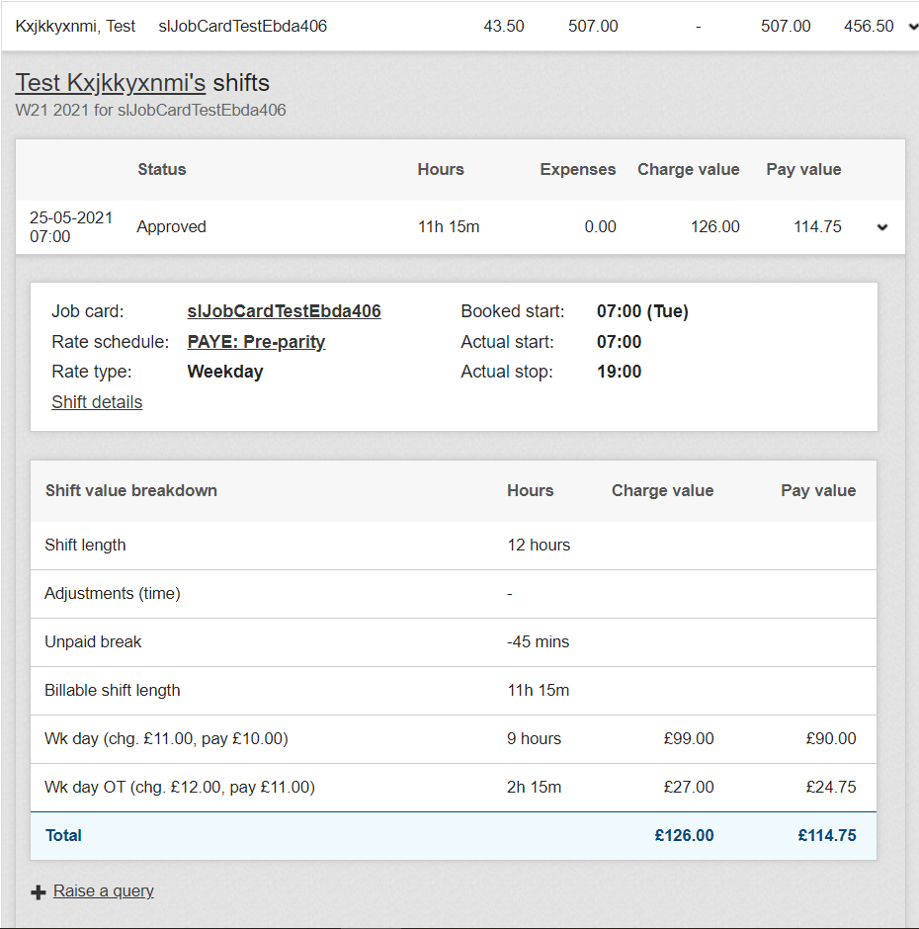
How To Raise The Query?
Open the timesheet you need to make the changes to.
Click on the 1 shift at the top
Click on Raise a qu this then will enable you to make changes.

Slide 18
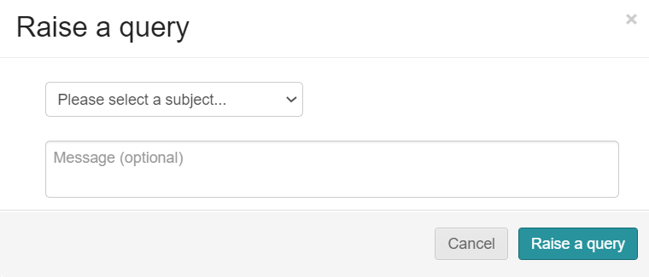
How To Complete The Query?
Open the query and select from the dropdown the reason for the query.
You can also add notes to message the worker regarding the query.

Slide 19
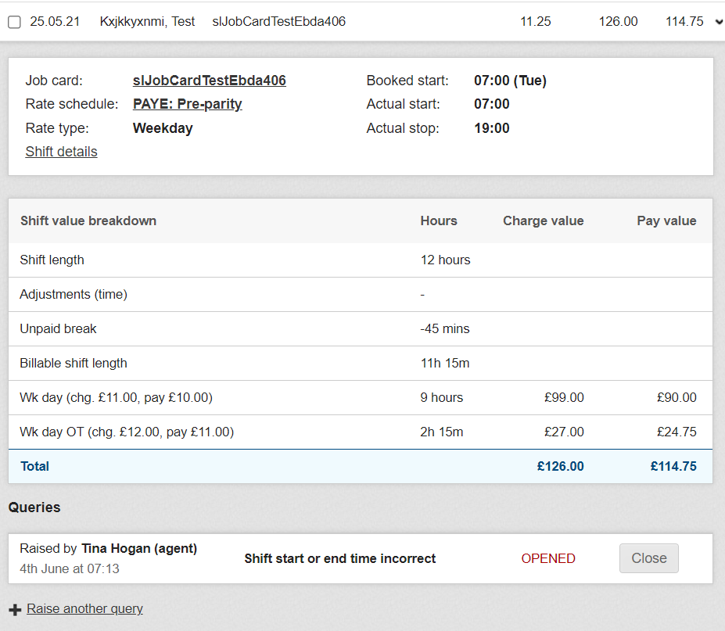
Where To Open And View Shift Details To Amend?
Go to Finance > Queried shifts.
Open the query you have created and click on shift details.

Slide 20
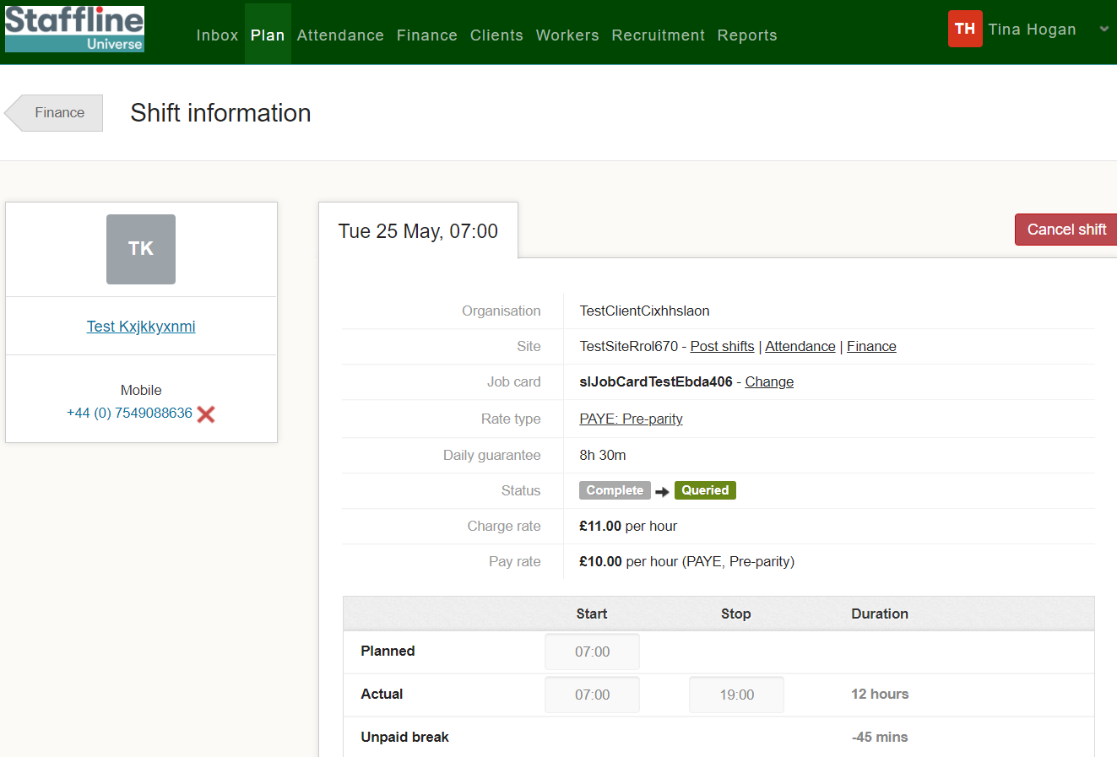
Where To Change The Time?
Click on the actual start time and change the start time to the correct time.

Slide 21
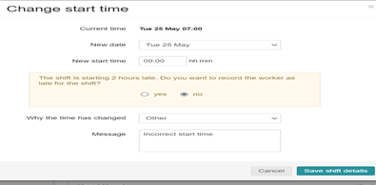
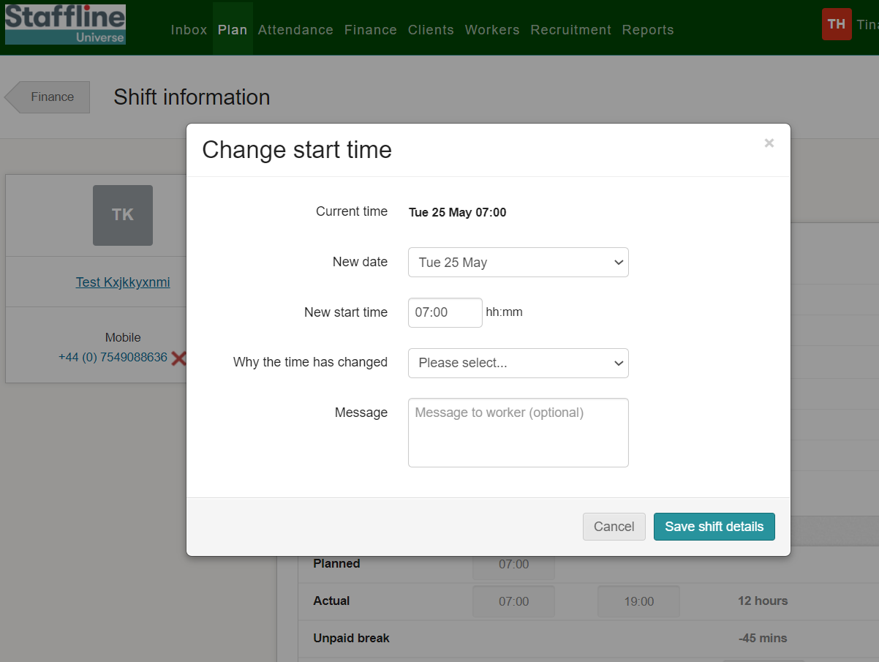
Where To Change The Time And Add Reason?
Add in the new time and use the dropdown to add in the reason. If required add a message for the worker. You will get a pop up advising on the start time, was the worker late. Click 'No' Unless they were late.
Once completed press:

Slide 22
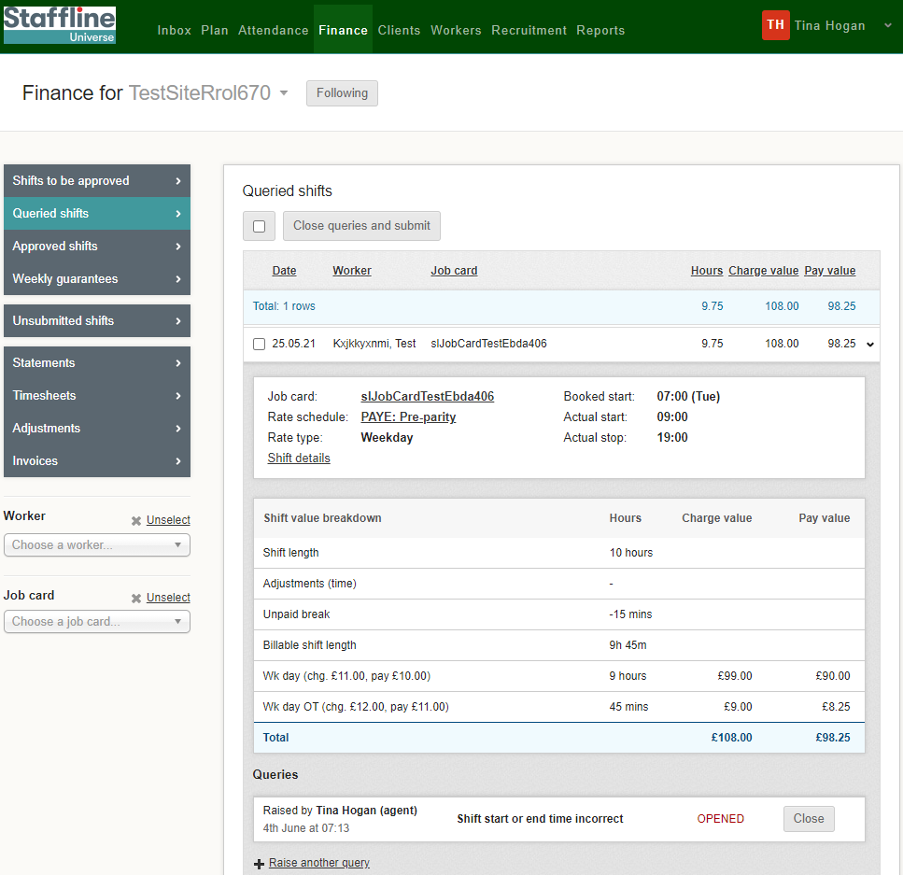
How To Close The Query?
There are two ways you can close a query under queries.
At the top of the page close queries and submit
Or close - if you click on close you will then need to resubmit your shift

Slide 23
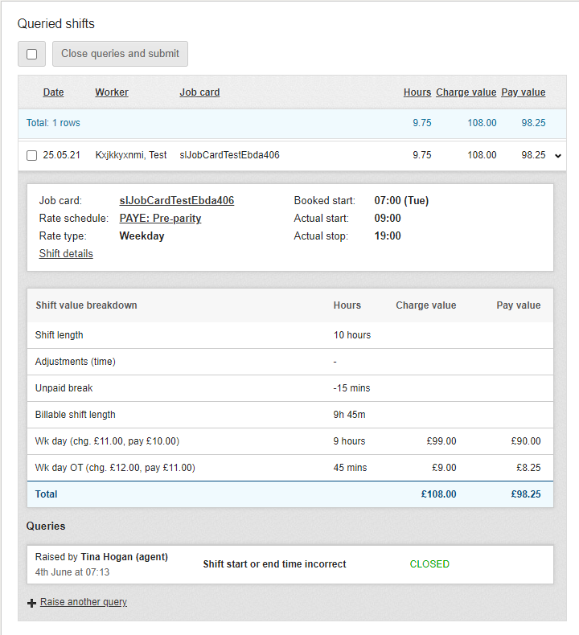
Where To View The Changes?
Once you have completed the changes you can view the closed query on the timesheet.
You have now completed how to amend, view and close a query!

Slide 24
WEEKLY GUARANTEES

Slide 25
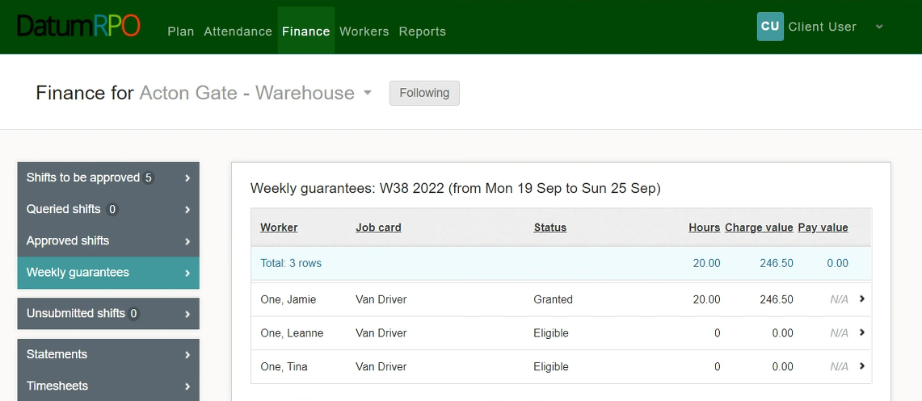
How Do I View & Action Weekly Guarantees?
To view and manage any weekly guarantees you may have, go to the ‘Finance’ tab and select ‘Weekly Guarantees’.
You will now see any workers how are eligible for weekly guarantees.

Slide 26
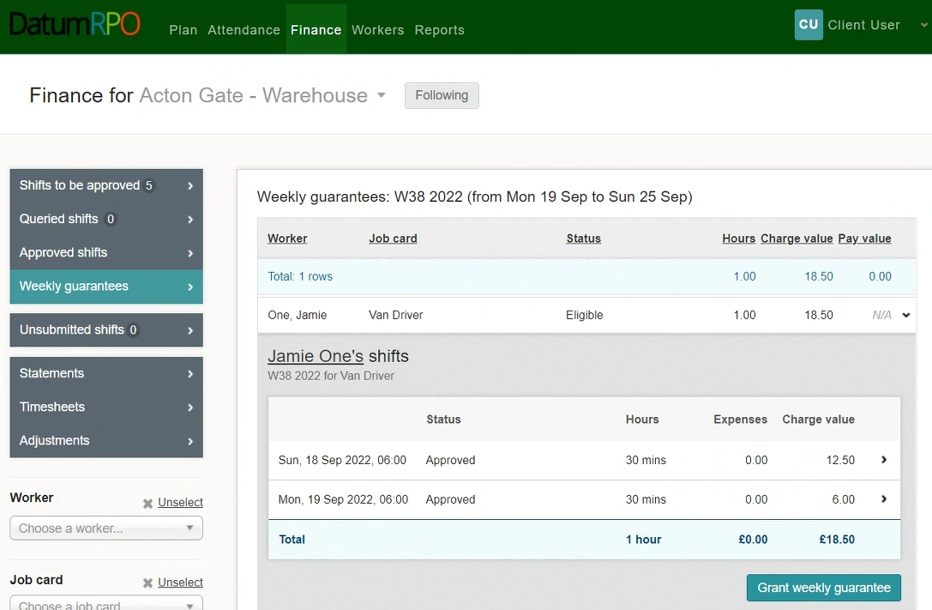
How Do I View & Action Weekly Guarantees?
To grant a workers weekly guarantees, click on the eligible workers banner to view the detail and then click
‘Grant Weekly Guarantees’.

Slide 27
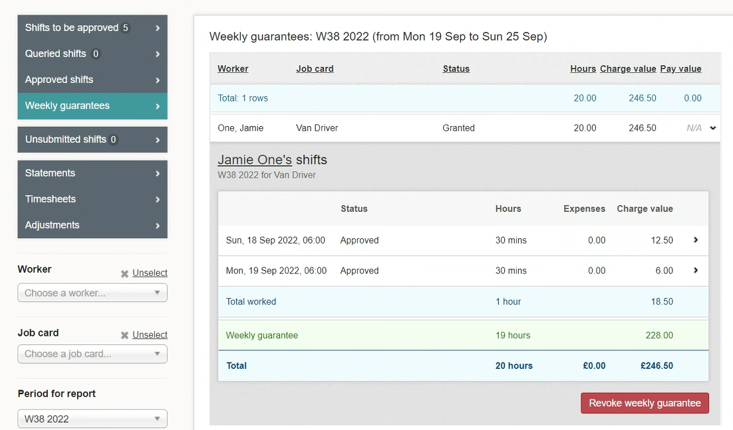
How Do I View & Action Weekly Guarantees?
Once the weekly guarantees have been granted, you will be able to view the details of the weekly guarantee and see the hours and charge value.

Slide 28
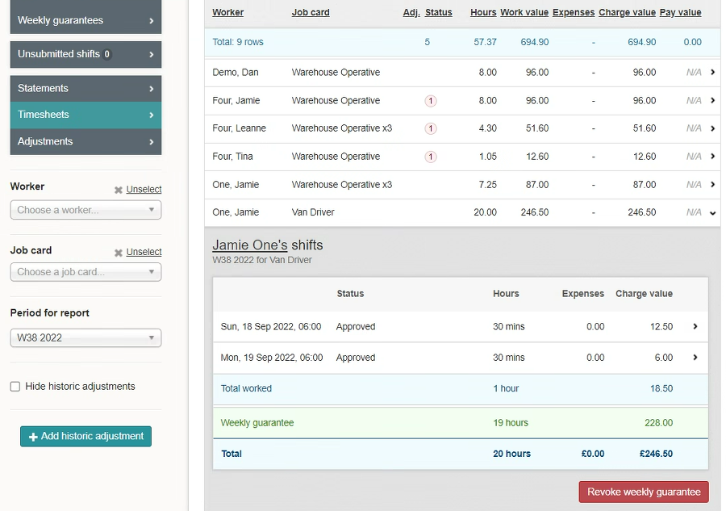
How Do I View & Action Weekly Guarantees?
If a weekly guarantee has been granted in error, you will be able to remove it by clicking ‘Revoke Weekly Guarantee. This will remove the weekly guarantee & restore the timesheet to its original state.

Slide 29
STATEMENTS

Slide 30
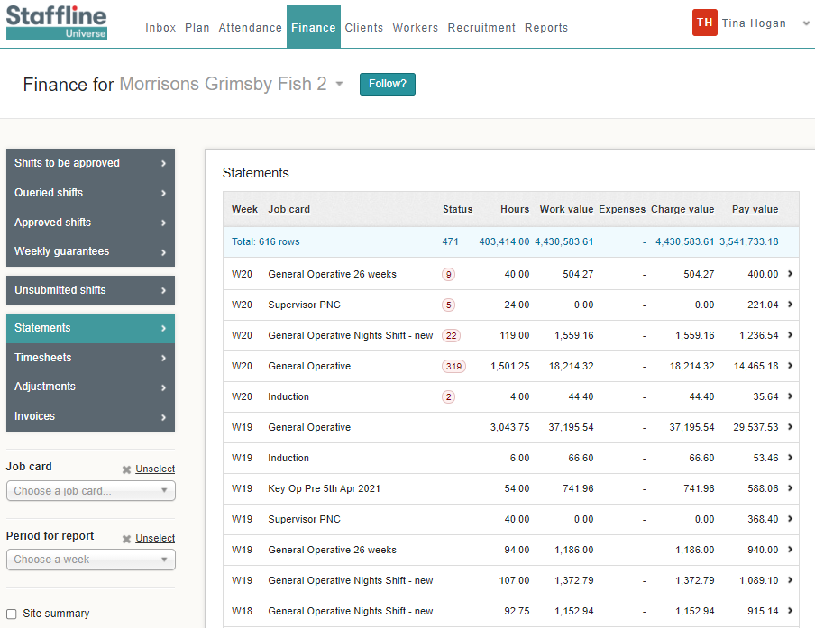
How To Find Statements?
Go to Finance > Statements
This gives you past or present timesheets where you can review hours and costings per job card.

Slide 31
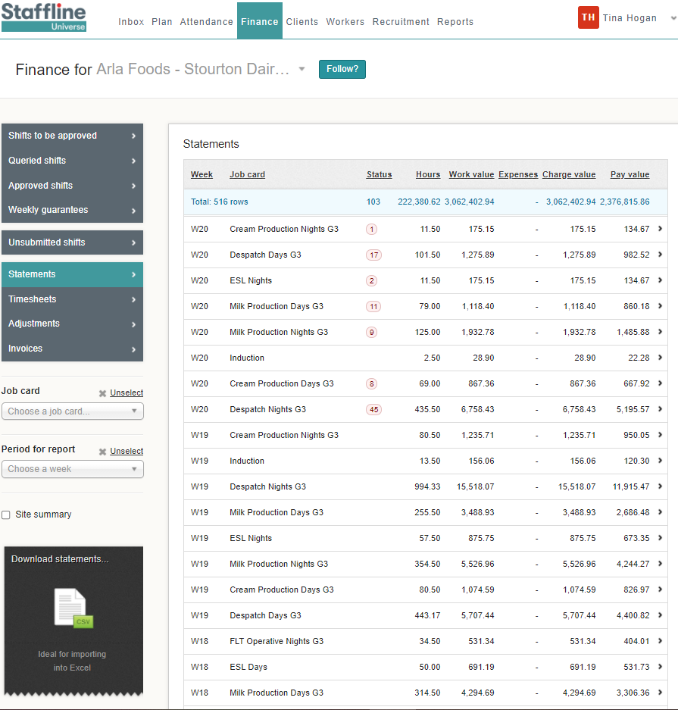
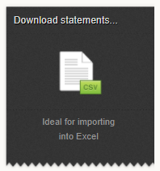
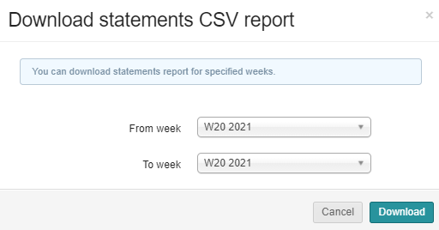
How To View Statements?
You can view a statement by downloading the CSV into excel spreadsheet.
Client on the week or weeks you require and click on download.

Slide 32
MANUAL ADJUSTMENTS -
BONUS

Slide 33
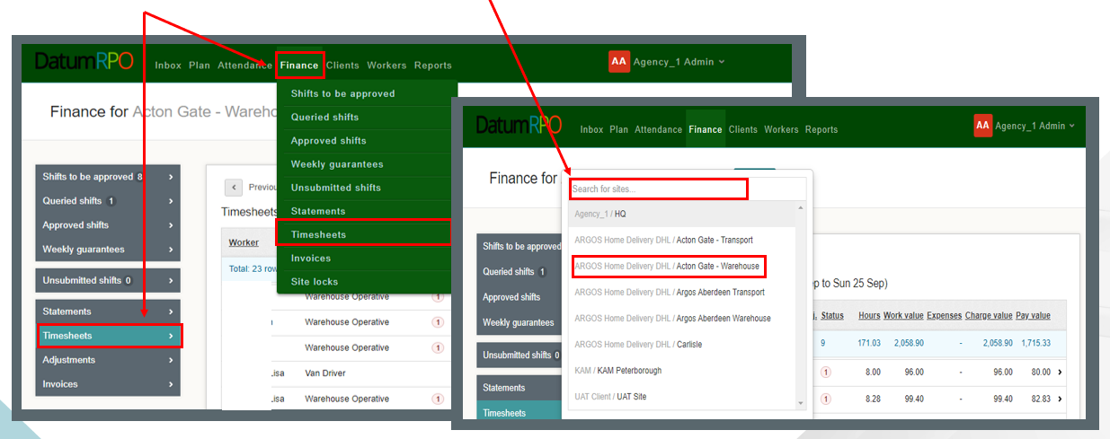
What Is A Manual Adjustment?
A manual adjustment can be entered at any time if there is a timesheet. A manual adjustment is where we need to deduct, refund or pay a shift bonus. The correct way to process this is through a manual adjustment and not an historic adjustment.
Click on Finance > Timesheets and search for your site.

Slide 34
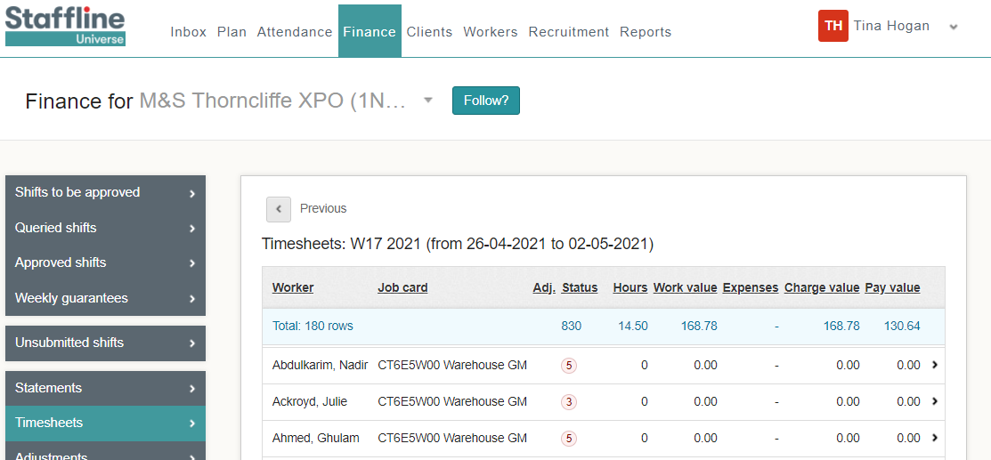
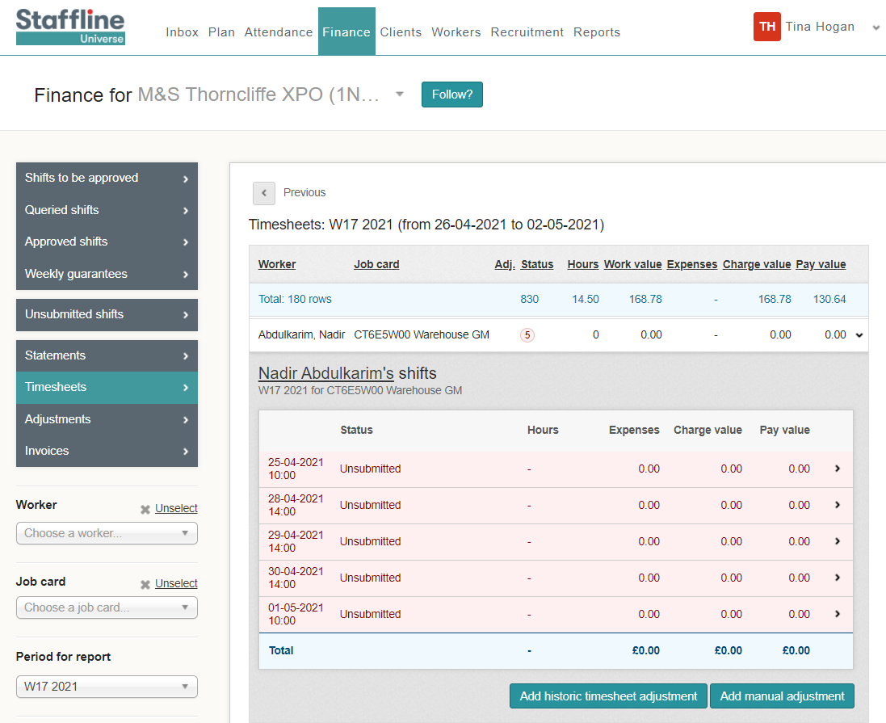
Where To Find Manual Adjustment To Add Shift Bonus?
To add a manual adjustment, click on the worker you require to make the adjustment to and open the timesheet.
cv
Next click on

Slide 35
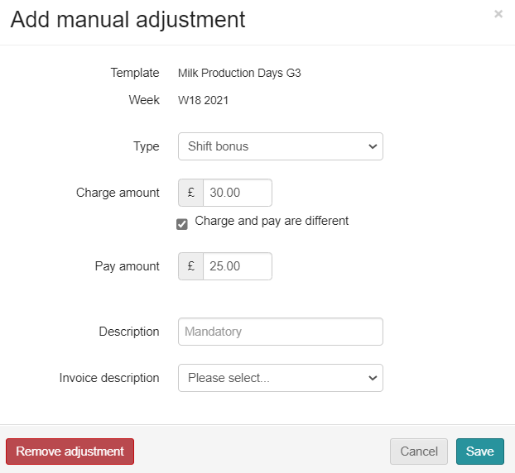
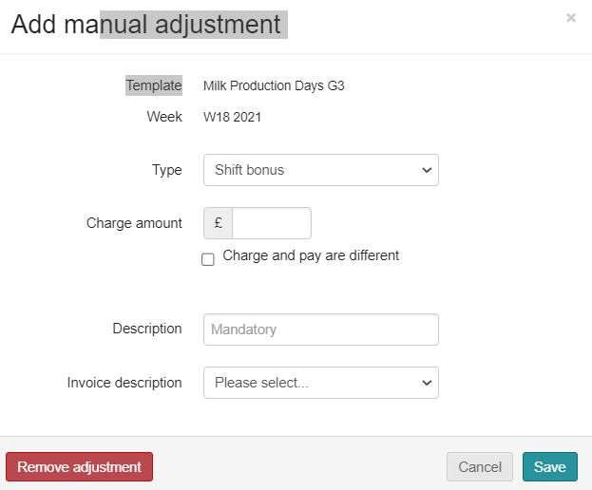
How To Add A Manual Shift Bonus Adjustment?
The manual adjustment can be entered at any time, if there is a timesheet.
Shift bonus payments are for any extra pay that is a bonus, and the worker doesn’t accrue holiday pay. This means it doesn’t go through the shift allocation but is done as a manual adjustment or a download adjustment.
Go to type and click in the box.
You will then see your drop down and click on shift bonus.
Next click on the charge amount then add the payment amount click on the
box and add amount.

Slide 36
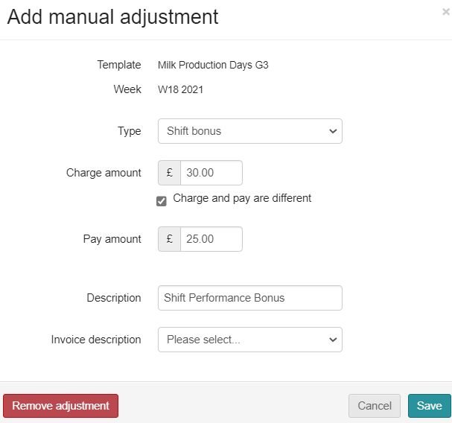
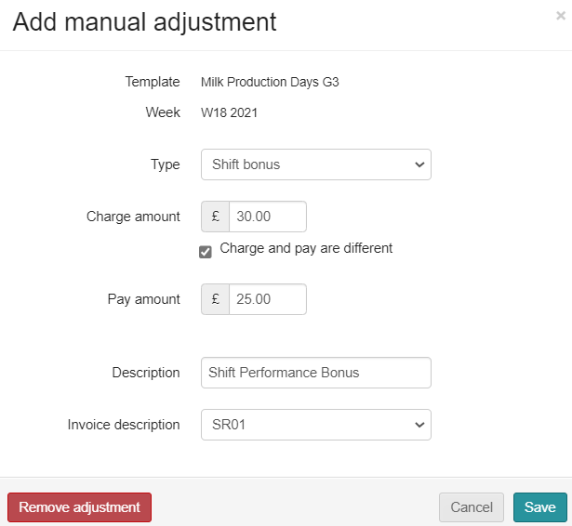
How To Add A Manual Shift Bonus Adjustment?
Next you need to add your description and invoice description.
Go to Description, click in the box and type in what it is for.
Last thing is to click on invoice description and select SR01 from the drop down.
If shift bonus is for supervisor check in don’t add charge amount, add in description 'Supervisor Check In'.

Slide 37
How To Complete A Manual Shift Bonus Adjustment?
Finally do your check list before saving.
Correct Type ✓
Correct Charge amount ✓
Correct Pay amount ✓
Correct Description ✓
Correct Invoice description ✓
Then click on

Slide 38
HISTORIC ADJUSTMENTS
RATES

Slide 39
What Is A Historic Adjustment?
A historic adjustment is where we have missed payment for a worker. It might be basic hours, overtime or backpay. This is the correct way to process missing payments and not through manual adjustments.
Click on Finance > Timesheets and then search for your site.

Slide 40
How To Add An Historic Adjustment?
To add an historic adjustment, click on the worker you require to make the adjustment to and open the timesheet.
cv
Next click on

Slide 41
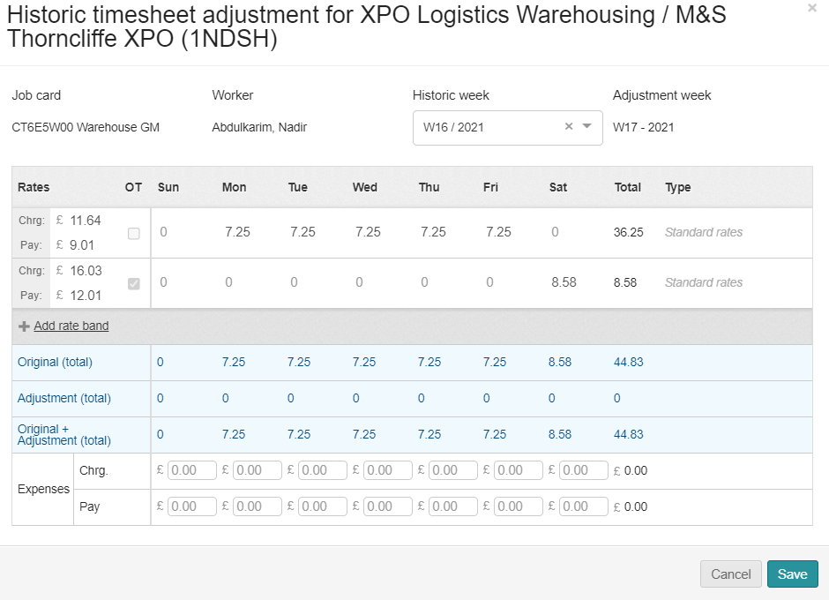
How To Add An Adjustment To The Relevant Week?
When adding an adjustment for a historic week you must ensure you are on the week you need to pay and the week the payment was missing from.
Adjustment week is the current week that you are payrolling.
Historic week is the week you need to pay the worker.
Click on the relevant week for the Historic Adjustment.

Slide 42
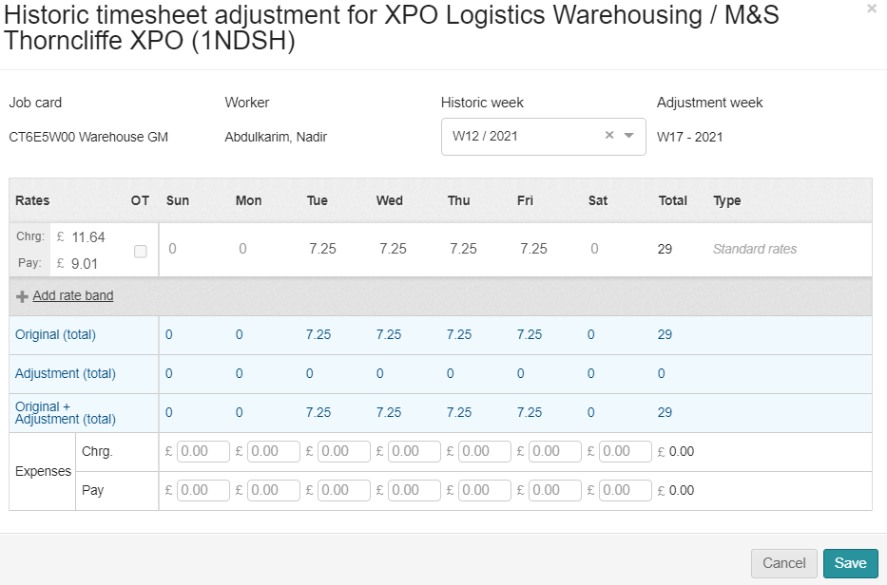
How To Add In The Charge And Pay Rate Difference?
Next, we need to add the rate band which will bring up charge rate and the pay rate for processing the hours.
You must ensure a charge rate is processed and not just a pay only.
Now add the difference of the charge rate and the pay rate. You can work this out by the difference between the New Pay Rate and Old Pay Rate. Then do the same with the charge rate.

Slide 43
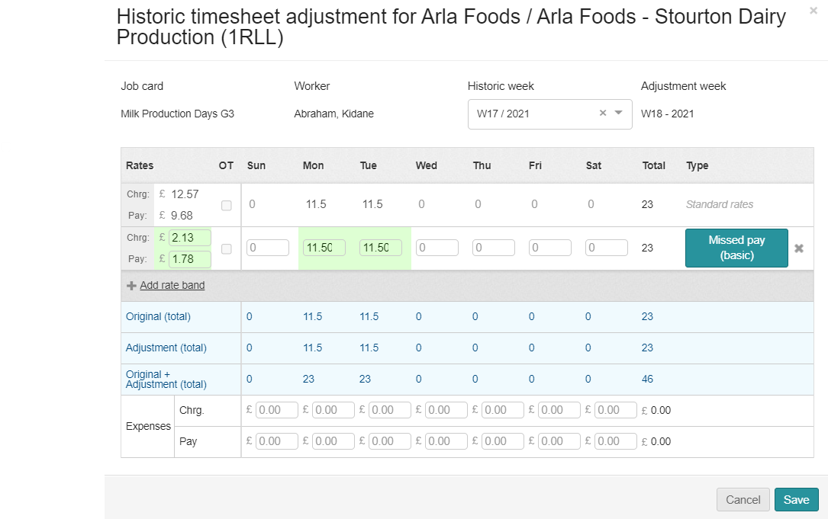
How To Add In The Hours?
Now we have added the charge and pay rate difference, we now need to add the hours in the correct day of which the hours need to be the same as the hours for the week you are adjusting.

Slide 44
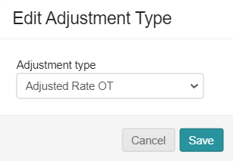
How To Add In Standard Rate Information?
Once with have opened the edit adjustment section, you need to select either Missed pay (basic), Missed pay (overtime),
Adjustment rate or Adjustment Rate Overtime ONLY.
Next click on Adjusted Rate or if overtime adjustment click Adjusted Rate OT.
This will be on your drop down.
Next click on the reason and

Slide 45
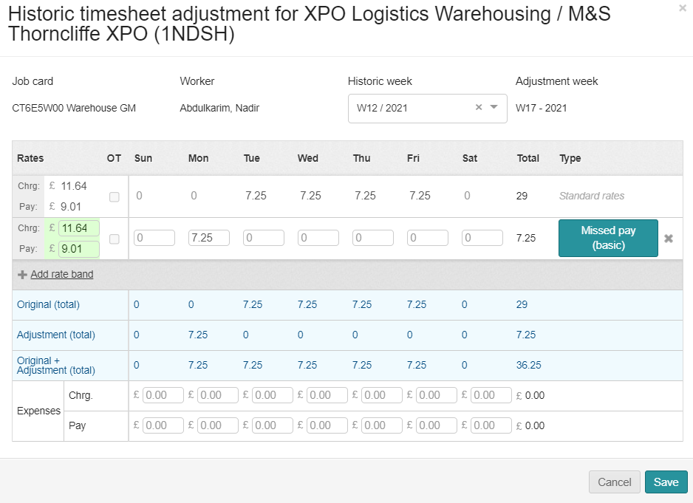
How To Check Before Saving?
We have now added all the information to save the adjustment. Next, we need to check to ensure the information is correct.
Correct Adjustment week of payment ✓
Correct Historic week of payment ✓
Correct Charge & Pay Rate Difference ✓
Correct Hours✓
Correct reason✓
Then click on
If you have inputted anything incorrect you will see the below message appear.

Slide 46
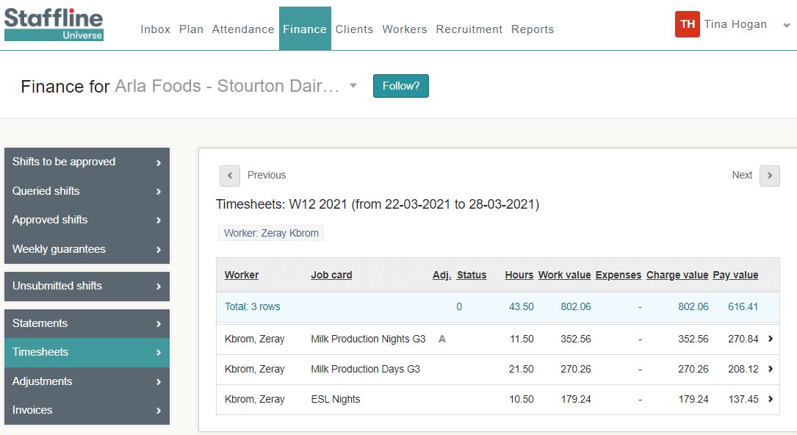
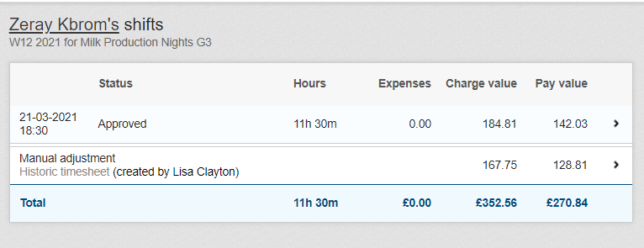
How To View The Adjustment In Timesheets?
The Adjustment has now been processed and there are two ways of finding the adjustment.
The first one is allocated on the timesheet
When you open the timesheet, you will see the adjustment.

Slide 47
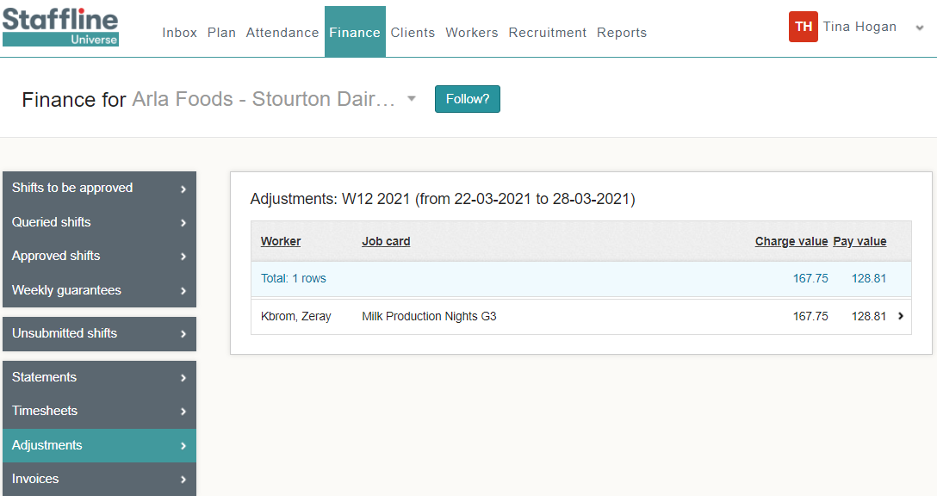
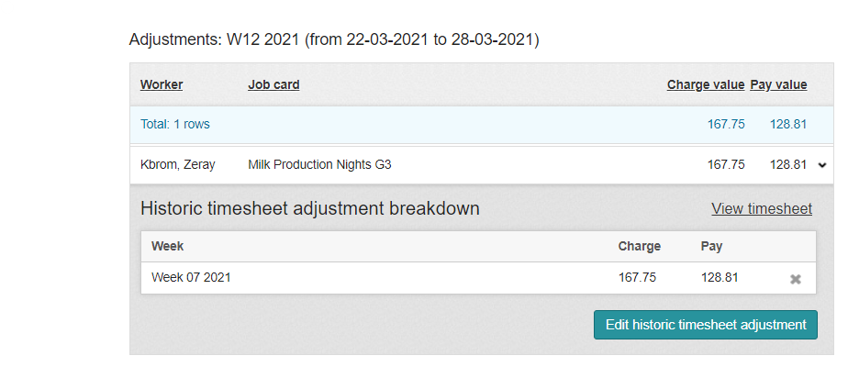
How To View The Adjustment In Adjustments?
The second way is to go to timesheets and on the left side you will see adjustments.
When you open the timesheet, you will see the adjustment. If required, you can adjust from here by clicking

Slide 48
HISTORIC ADJUSTMENTS
MISSING HOURS

Slide 49
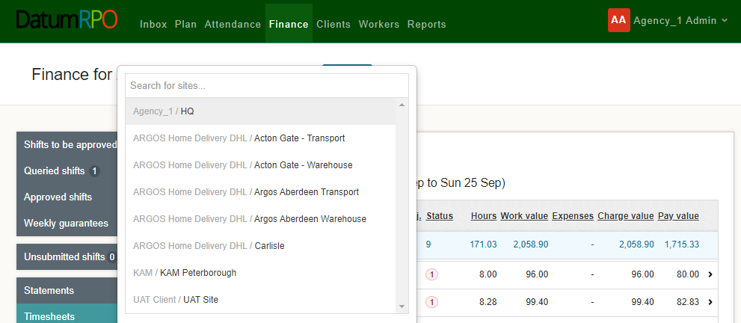
What Is An Historic Adjustment?
An historic adjustment is where we have missed payment for a worker. It might be basic hours, overtime or backpay. This is the correct way to process missing payments and not through manual adjustment.
Click on Finance > Timesheets and then search for your site.

Slide 50
How To Add An Historic Adjustment?
To add an historic adjustment, click on the worker you require to make the adjustment to and open the timesheet.
cv
Next click on

Slide 51
How To Add An Adjustment To The Relevant Week?
When adding an adjustment for a historic week you must ensure you are on the week you need to pay and the week the payment was missing from.
Adjustment week is the current week that you are payrolling.
Historic week is the week you need to pay the worker.
Click on the relevant week for the Historic Adjustment.

Slide 52
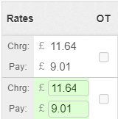
How To Add In The Charge And Pay Rate?
Next, we need to add the rate band which will bring up charge rate and the pay rate for processing the hours.
You must ensure a charge rate is processed and not just a pay only.
Now add in the charge rate and the pay rate.

Slide 53
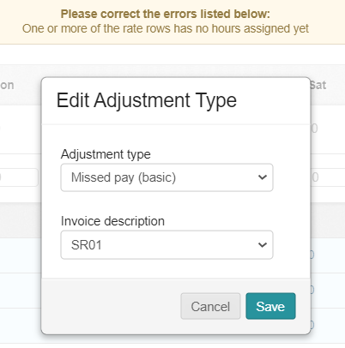
How To Add In The Hours?
Now we have added the charge and pay rate we now need to add the hours in the correct day of which the hours were missing.
Next, click on Missed pay and add in the reason (if missed pay (basic) you don’t need to click and change).
This will then bring up a drop down to select reason.

Slide 54
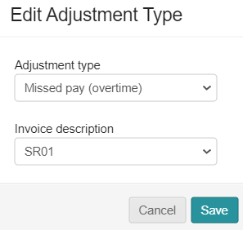
How To Add In Standard Rate Information?
Once you have opened the Edit Adjustment you need to select either Missed pay (basic), Missed pay (overtime),
Adjustment Rate or Adjustment Rate Overtime ONLY.
Next click on the reason and

Slide 55
How To Check Before Saving?
We have now added all the information to save the adjustment. Next, we need to check to ensure the information is correct.
Correct Adjustment week of payment ✓
Correct Historic week of payment ✓
Correct Charge & Pay Rate ✓
Correct Hours✓
Correct reason✓
Then click on
If you have inputted anything incorrect you will see the below message appear.

Slide 56
How To View The Adjustment In Timesheets?
The Adjustment has now been processed and there are two ways of finding the adjustment.
The first one is allocated on the timesheet
When you open the timesheet, you will see the adjustment.

Slide 57
How To View The Adjustment In Adjustments?
The second way is to go to timesheets and on the left side you will see adjustments.
When you open the timesheet, you will see the adjustment. If required, you can adjust here by clicking

Slide 58
APPROVED SHIFTS
CLIENT PROCESS

Slide 59
How To Approve Shifts?
Approved shifts need to either be completed daily or weekly. Deadline for hours daily is agreed with your agency.
Weekly needs to be approved 12 noon Monday (with the exception of bank holidays ie Christmas and Easter)

Slide 60
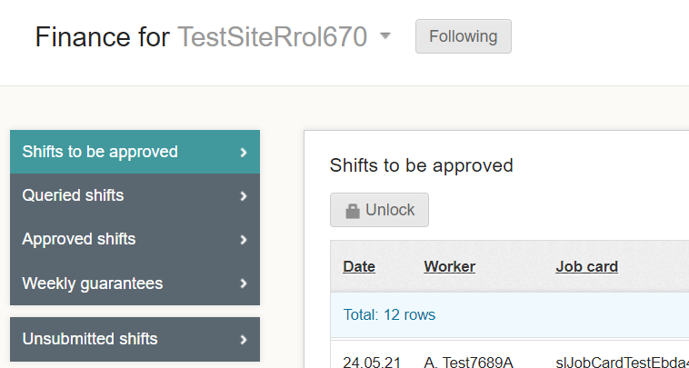
Where To Find Shifts To Be Approved?
This process happens after the shift has been submitted and continues the process of locking the payroll. The process will need to be completed by your client, find your site, go to Finance > Shifts to be approved.
Next Unlock the shifts to approve.

Slide 61
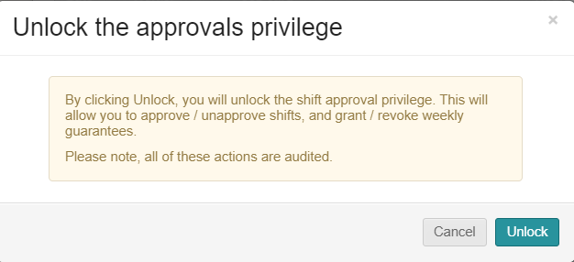
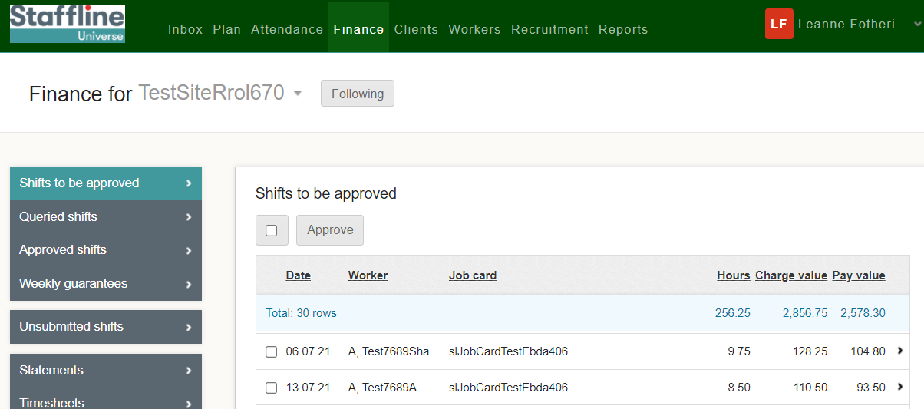
How To Approve Shifts?
Client can now approve the shifts either individually or select all shifts.
Then a warning sign will pop up, and your client will need to press

Slide 62
WORKERS OVERVIEW

Slide 63
WORKERS SEARCH

Slide 64
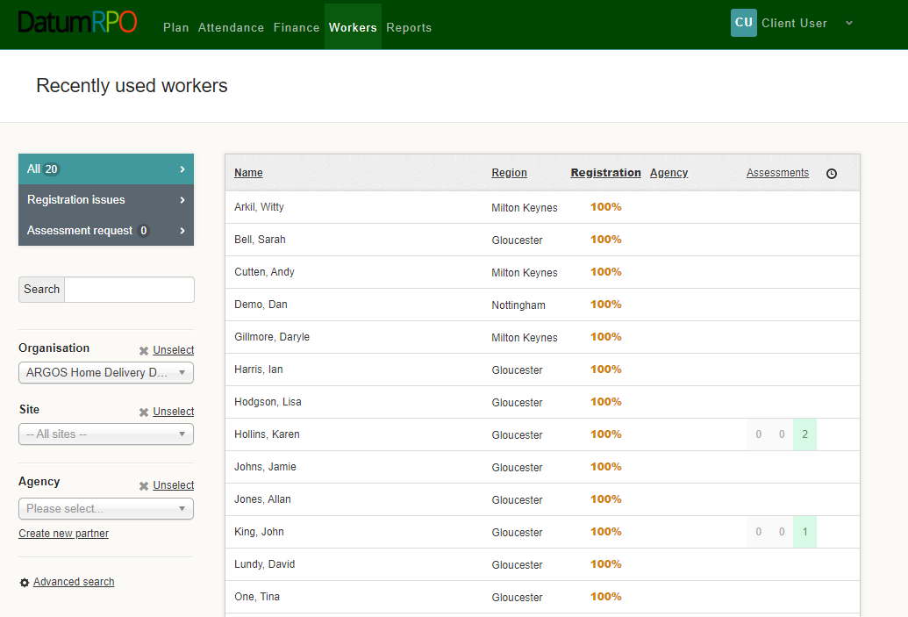
How To View Workers Page?
Go to Workers
All – Recently Used Workers
This area shows you -
Name
Region
Registration Status which should be 100%
Agency
Assessment
Clock is where you can add reminders
Which Workers Have Had Assessments

Slide 65
How Do I Search For A Worker?
You can type in the workers name from this section
Add In Your Organisation to filter down the workers
Add In Your Site to reduce the filter down more
Add In Your Agency to reduce the filter

Slide 66
WORKERS PROFILE

Slide 67
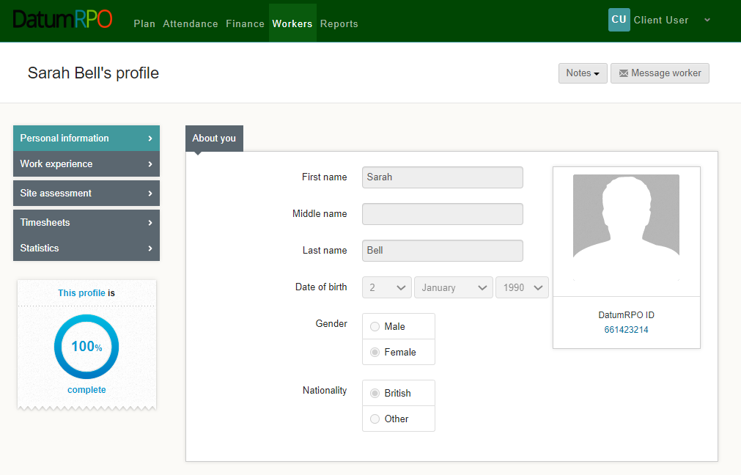
How To View A Workers Profile And Each Section?
The worker's profile Information page as limited information for you to view.
The section to message workers is not available
You can see
Name
Surname
DOB
Gender
Nationality
Workers ID Number
This section shows if the workers profile is complete

Slide 68
How To View A Workers Profile And Each Section?
In the section Notes you can click on the icon and add a note to the worker's profile.
Please Note
The notes wont automatically advise the agency

Slide 69
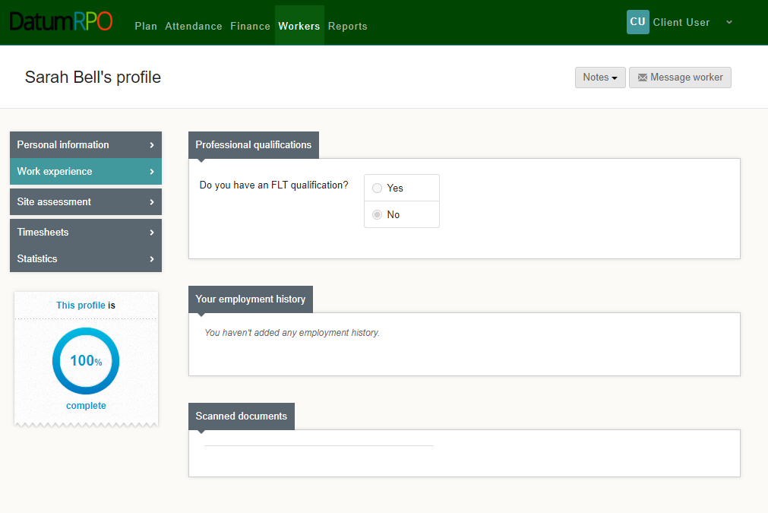
How To View A Workers Profile And Each Section?
This page shows the worker experience. This page will have limited information.
Do they have a FLT qualification Yes/No?
Any documents uploaded

Slide 70
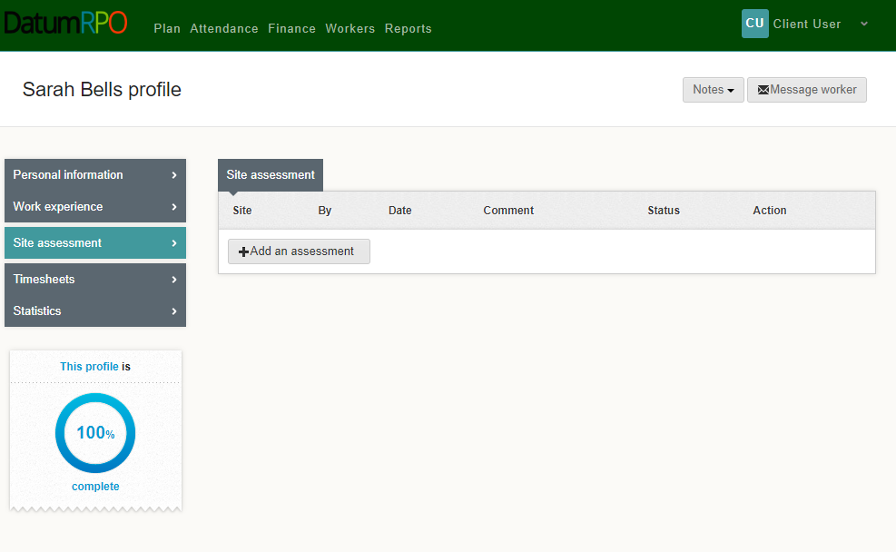
How To View A Workers Profile And Each Section?
Site assessment will show any assessments that have been completed and when

Slide 71
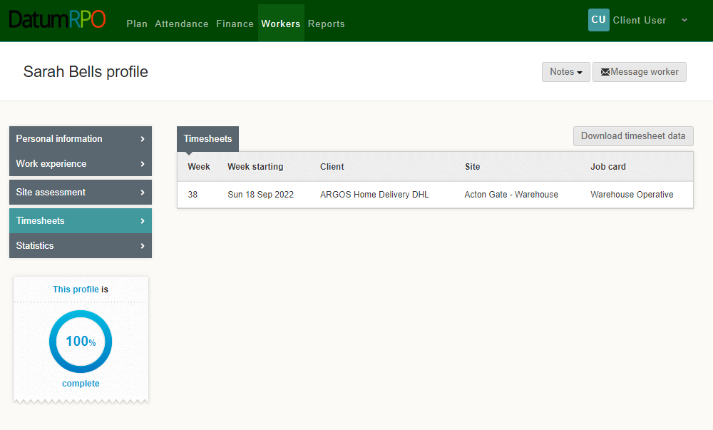
How To View A Workers Profile And Each Section?
Timesheets are any shifts/hours completed by the worker with charge rates.
Here you can download the data

Slide 72
How To View A Workers Profile And Each Section?
Statistics – This information pages shows the workers attendance and absence

Slide 73
REPORTS OVERVIEW

Slide 74
COMING SOON

