Slide 1
CLIENT
“HOW TO DO GUIDE”

Slide 2
APPROVED SHIFTS
CLIENT PROCESS

Slide 3
How To Approve Shifts?
Approved shifts need to either be completed daily or weekly. Deadline for hours daily is agreed with your agency.
Weekly needs to be approved 12 noon Monday (with the exception of bank holidays ie Christmas and Easter)

Slide 4
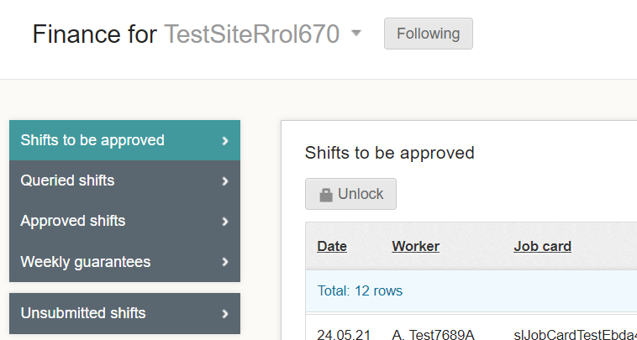
Where To Find Shifts To Be Approved?
This process happens after the shift has been submitted and continues the process of locking the payroll. The process will need to be completed by your client, find your site, go to Finance > Shifts to be approved.
Next Unlock the shifts to approve.

Slide 5
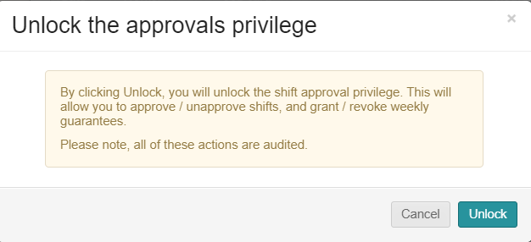
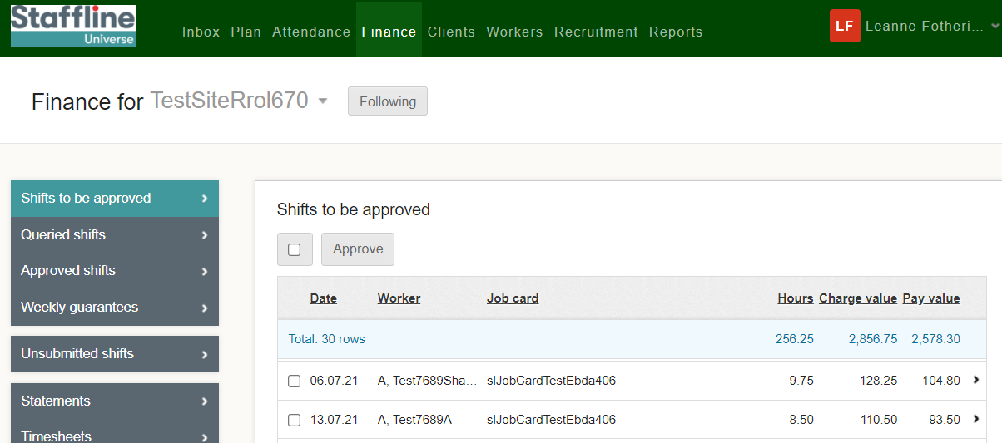
How To Approve Shifts?
Client can now approve the shifts either individually or select all shifts.
Then a warning sign will pop up, and your client will need to press

Slide 6
WORKERS OVERVIEW

Slide 7
WORKERS SEARCH

Slide 8
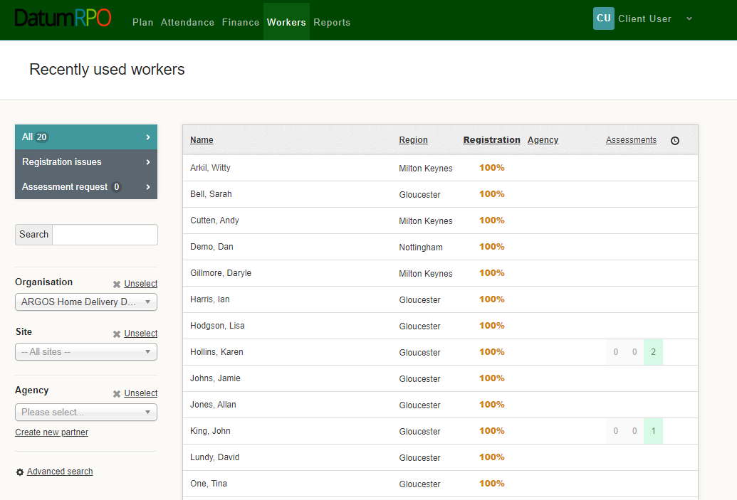
How To View Workers Page?
Go to Workers
All – Recently Used Workers
This area shows you -
Name
Region
Registration Status which should be 100%
Agency
Assessment
Clock is where you can add reminders
Which Workers Have Had Assessments

Slide 9
How Do I Search For A Worker?
You can type in the workers name from this section
Add In Your Organisation to filter down the workers
Add In Your Site to reduce the filter down more
Add In Your Agency to reduce the filter

Slide 10
WORKERS PROFILE

Slide 11
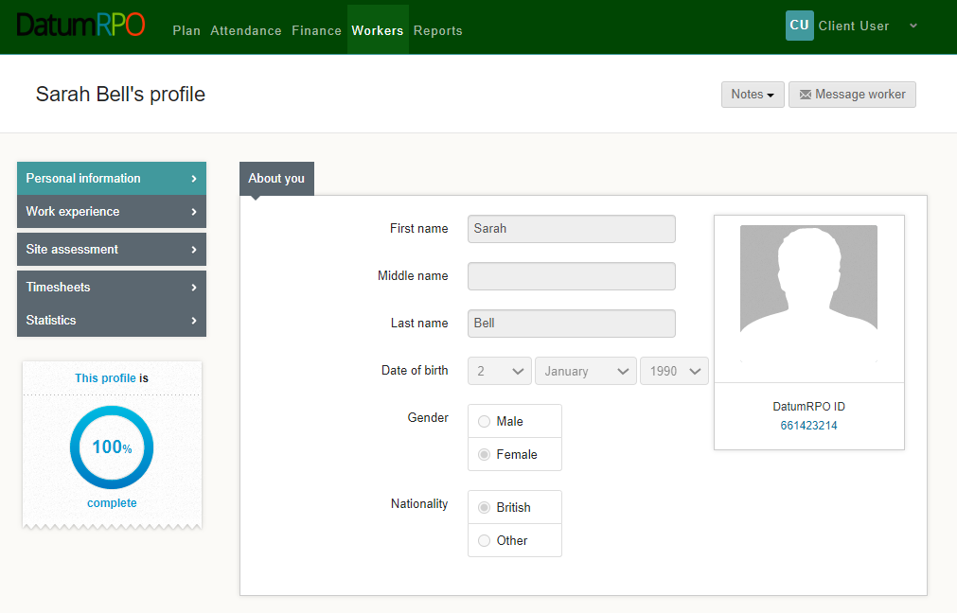
How To View A Workers Profile And Each Section?
The worker's profile Information page as limited information for you to view.
The section to message workers is not available
You can see
Name
Surname
DOB
Gender
Nationality
Workers ID Number
This section shows if the workers profile is complete

Slide 12
How To View A Workers Profile And Each Section?
In the section Notes you can click on the icon and add a note to the worker's profile.
Please Note
The notes wont automatically advise the agency

Slide 13
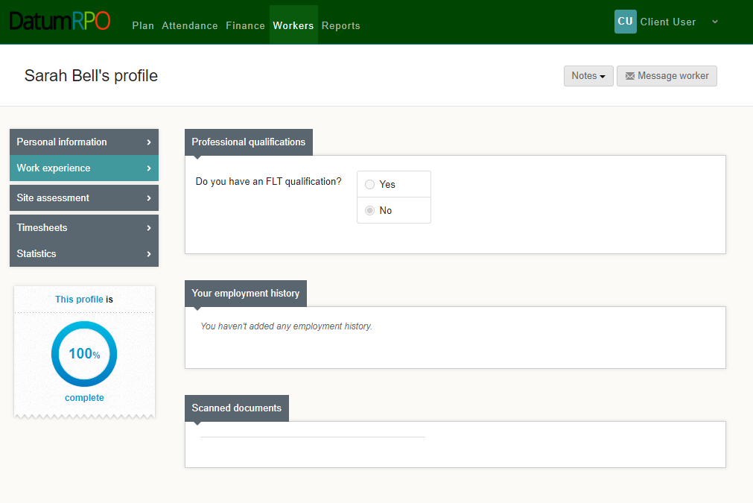
How To View A Workers Profile And Each Section?
This page shows the worker experience. This page will have limited information.
Do they have a FLT qualification Yes/No?
Any documents uploaded

Slide 14
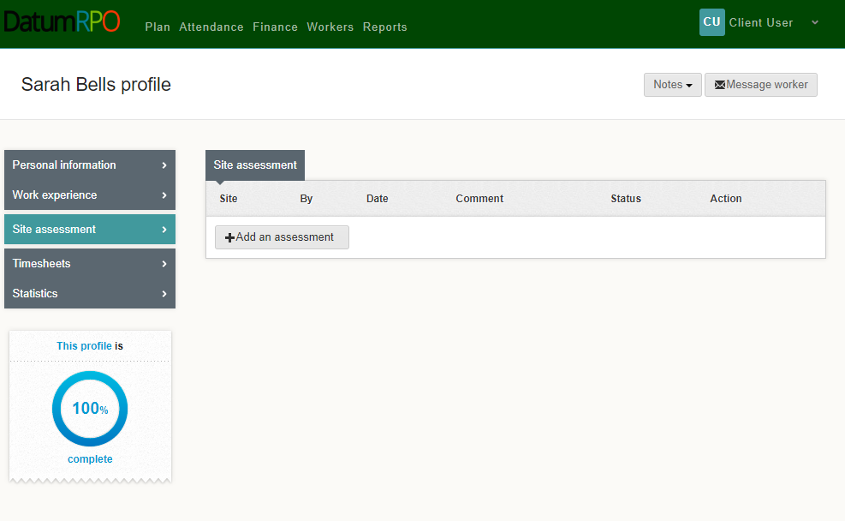
How To View A Workers Profile And Each Section?
Site assessment will show any assessments that have been completed and when

Slide 15
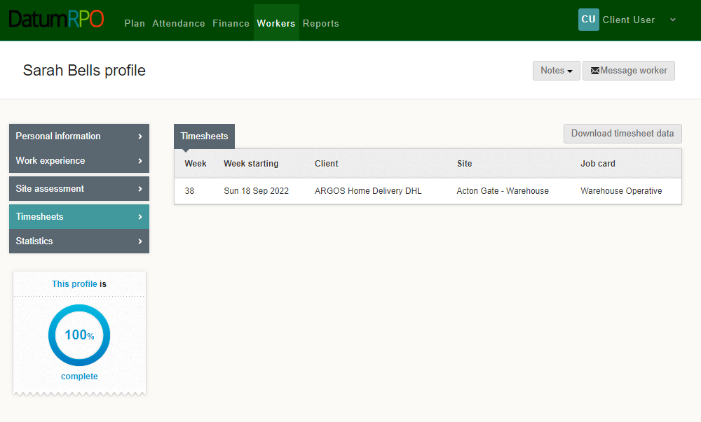
How To View A Workers Profile And Each Section?
Timesheets are any shifts/hours completed by the worker with charge rates.
Here you can download the data

Slide 16
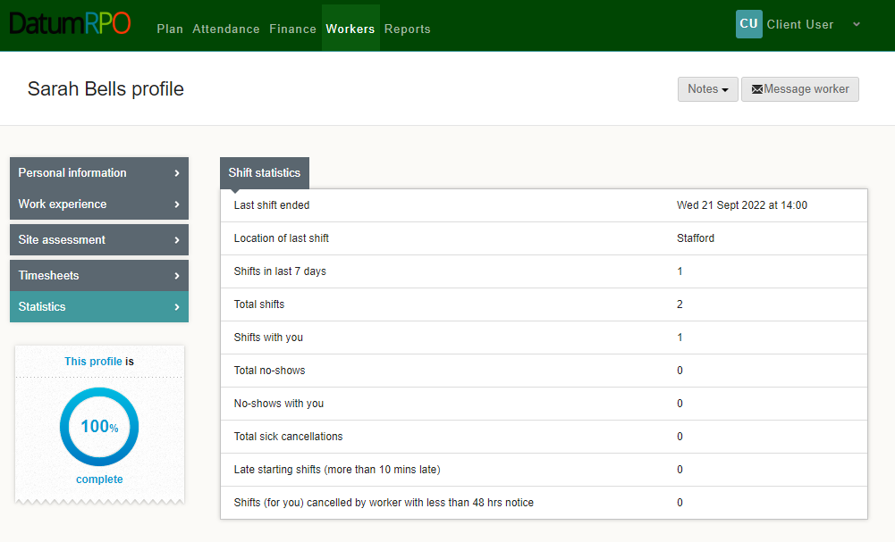
How To View A Workers Profile And Each Section?
Statistics – This information pages shows the workers attendance and absence

Slide 17
REPORTS OVERVIEW

Slide 18
COMING SOON

