Slide 1
CLIENT
“HOW TO DO GUIDE”

Slide 2
WORKERS OVERVIEW

Slide 3
WORKERS SEARCH

Slide 4
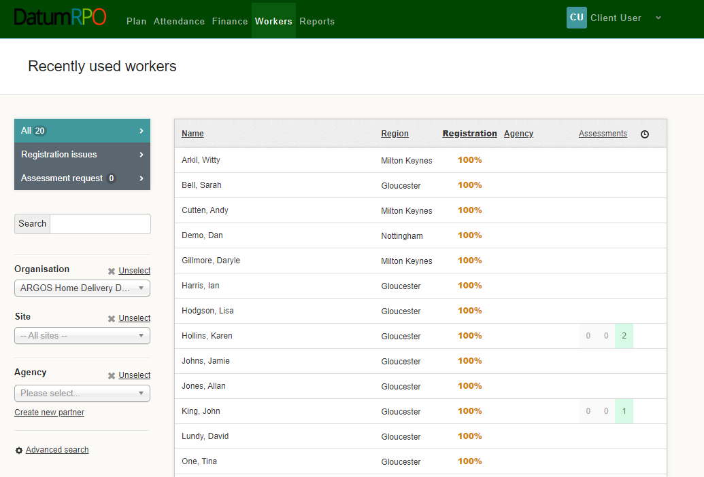
How To View Workers Page?
Go to Workers
All – Recently Used Workers
This area shows you -
Name
Region
Registration Status which should be 100%
Agency
Assessment
Clock is where you can add reminders
Which Workers Have Had Assessments

Slide 5
How Do I Search For A Worker?
You can type in the workers name from this section
Add In Your Organisation to filter down the workers
Add In Your Site to reduce the filter down more
Add In Your Agency to reduce the filter

