Slide 1
CLIENT
“HOW TO DO GUIDE”

Slide 2
WORKERS OVERVIEW

Slide 3
WORKERS PROFILE

Slide 4
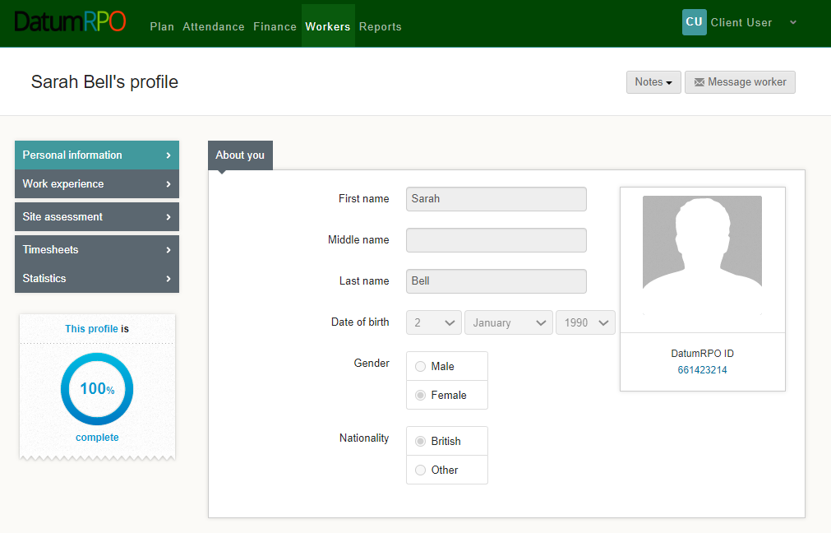
How To View A Workers Profile And Each Section?
The worker's profile Information page as limited information for you to view.
The section to message workers is not available
You can see
Name
Surname
DOB
Gender
Nationality
Workers ID Number
This section shows if the workers profile is complete

Slide 5
How To View A Workers Profile And Each Section?
In the section Notes you can click on the icon and add a note to the worker's profile.
Please Note
The notes wont automatically advise the agency

Slide 6
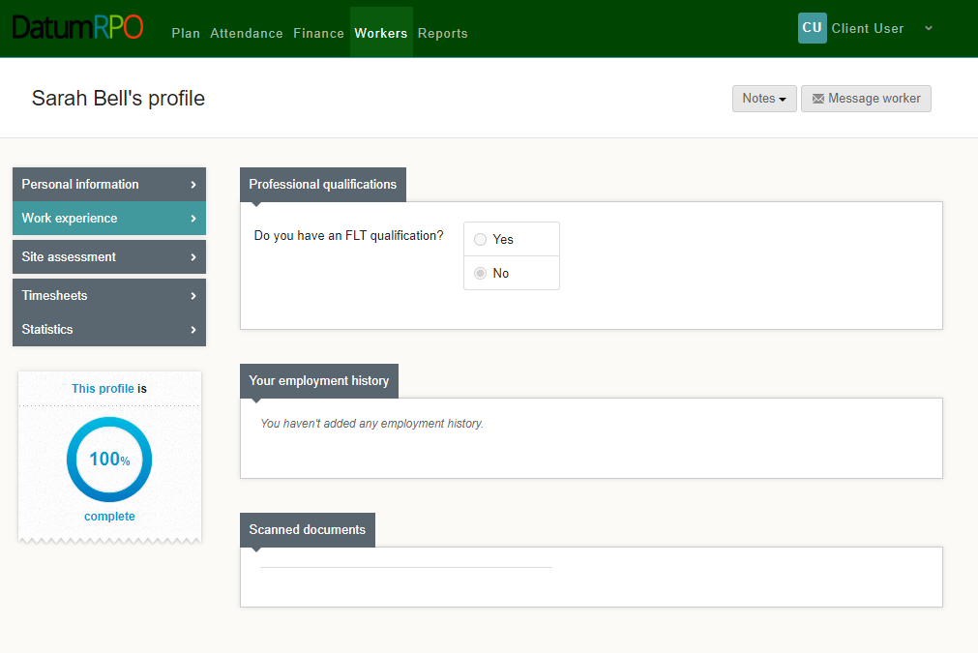
How To View A Workers Profile And Each Section?
This page shows the worker experience. This page will have limited information.
Do they have a FLT qualification Yes/No?
Any documents uploaded

Slide 7
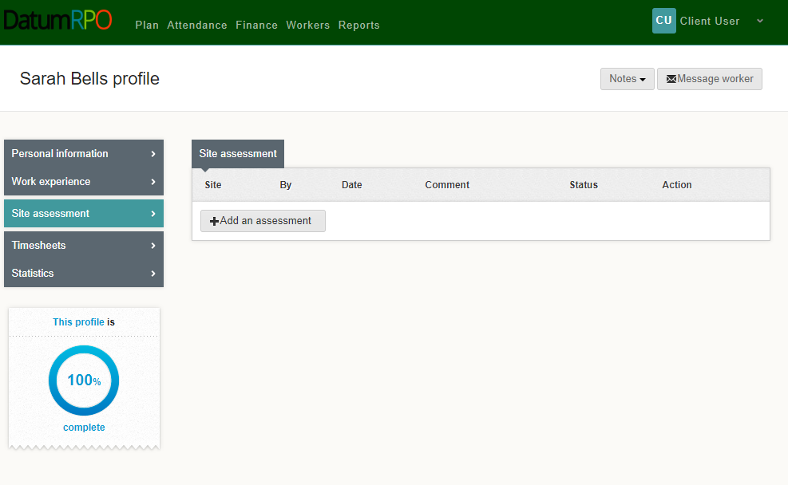
How To View A Workers Profile And Each Section?
Site assessment will show any assessments that have been completed and when

Slide 8
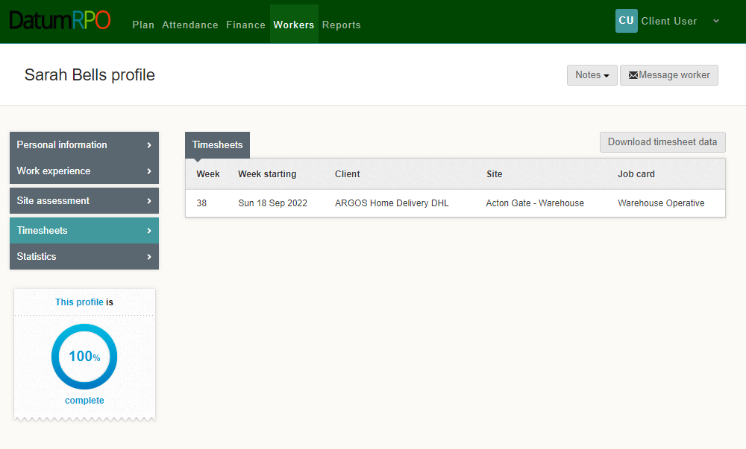
How To View A Workers Profile And Each Section?
Timesheets are any shifts/hours completed by the worker with charge rates.
Here you can download the data

Slide 9
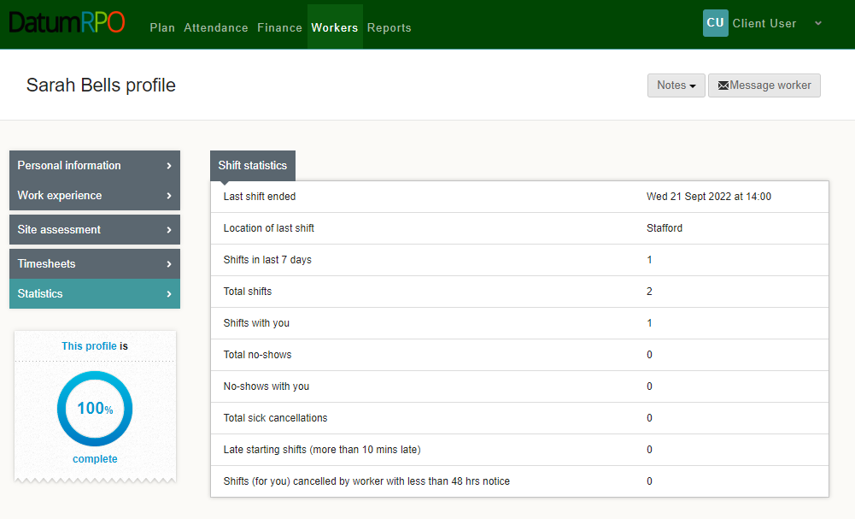
How To View A Workers Profile And Each Section?
Statistics – This information pages shows the workers attendance and absence

